Slide 1
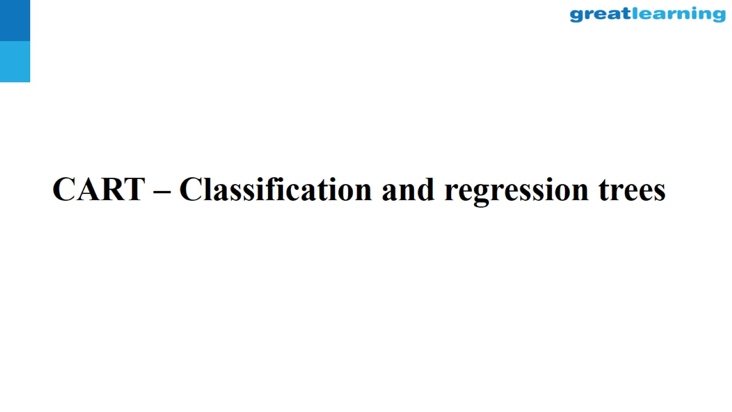
CART – Classification and regression trees

Slide 2
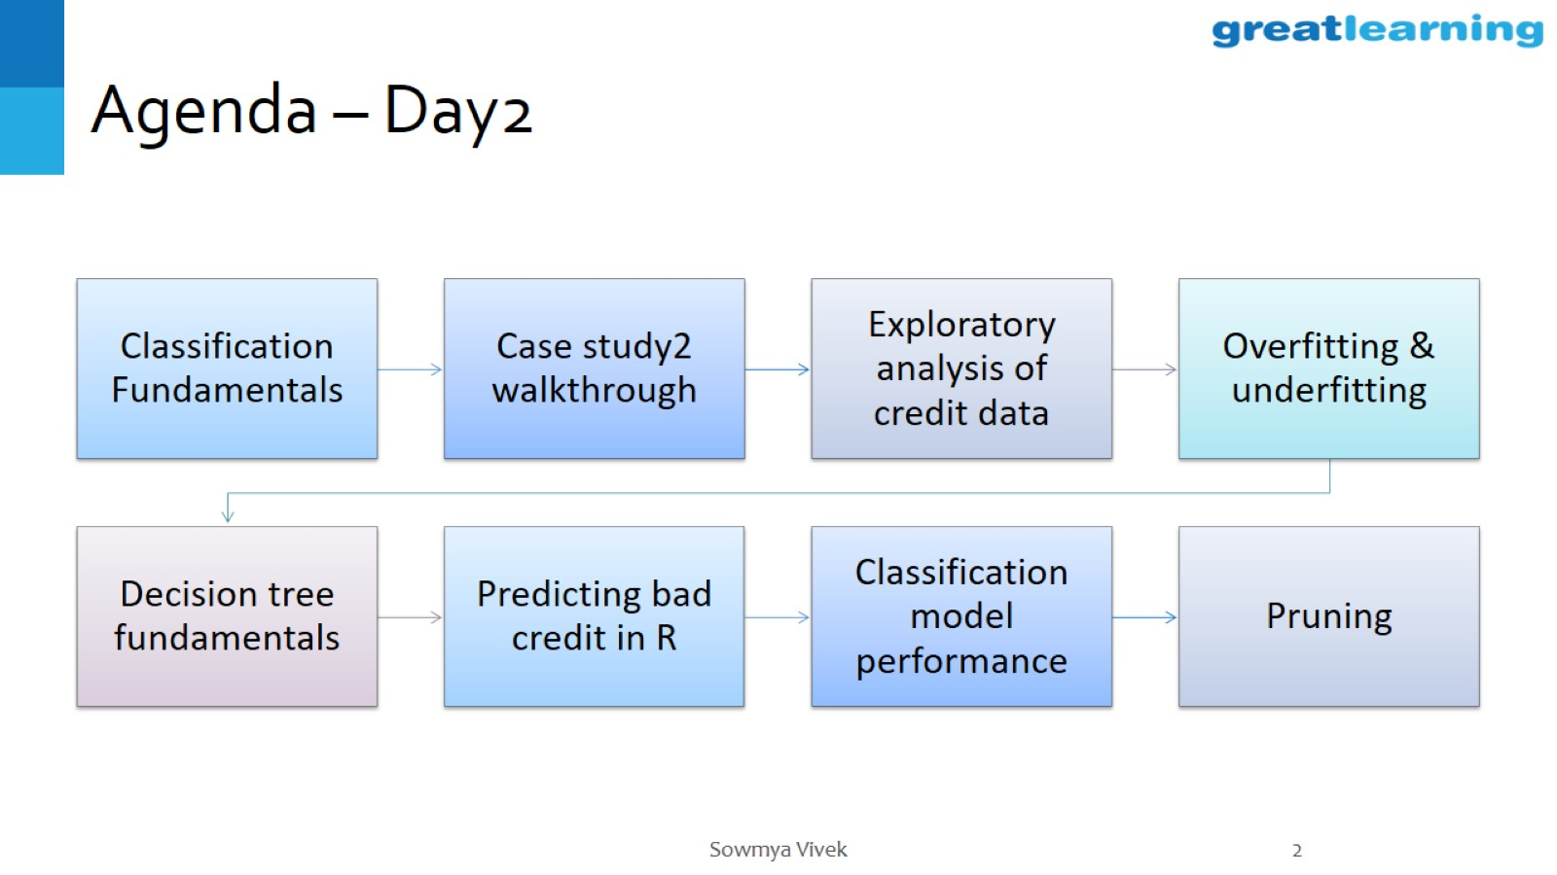
Agenda – Day2

Slide 3
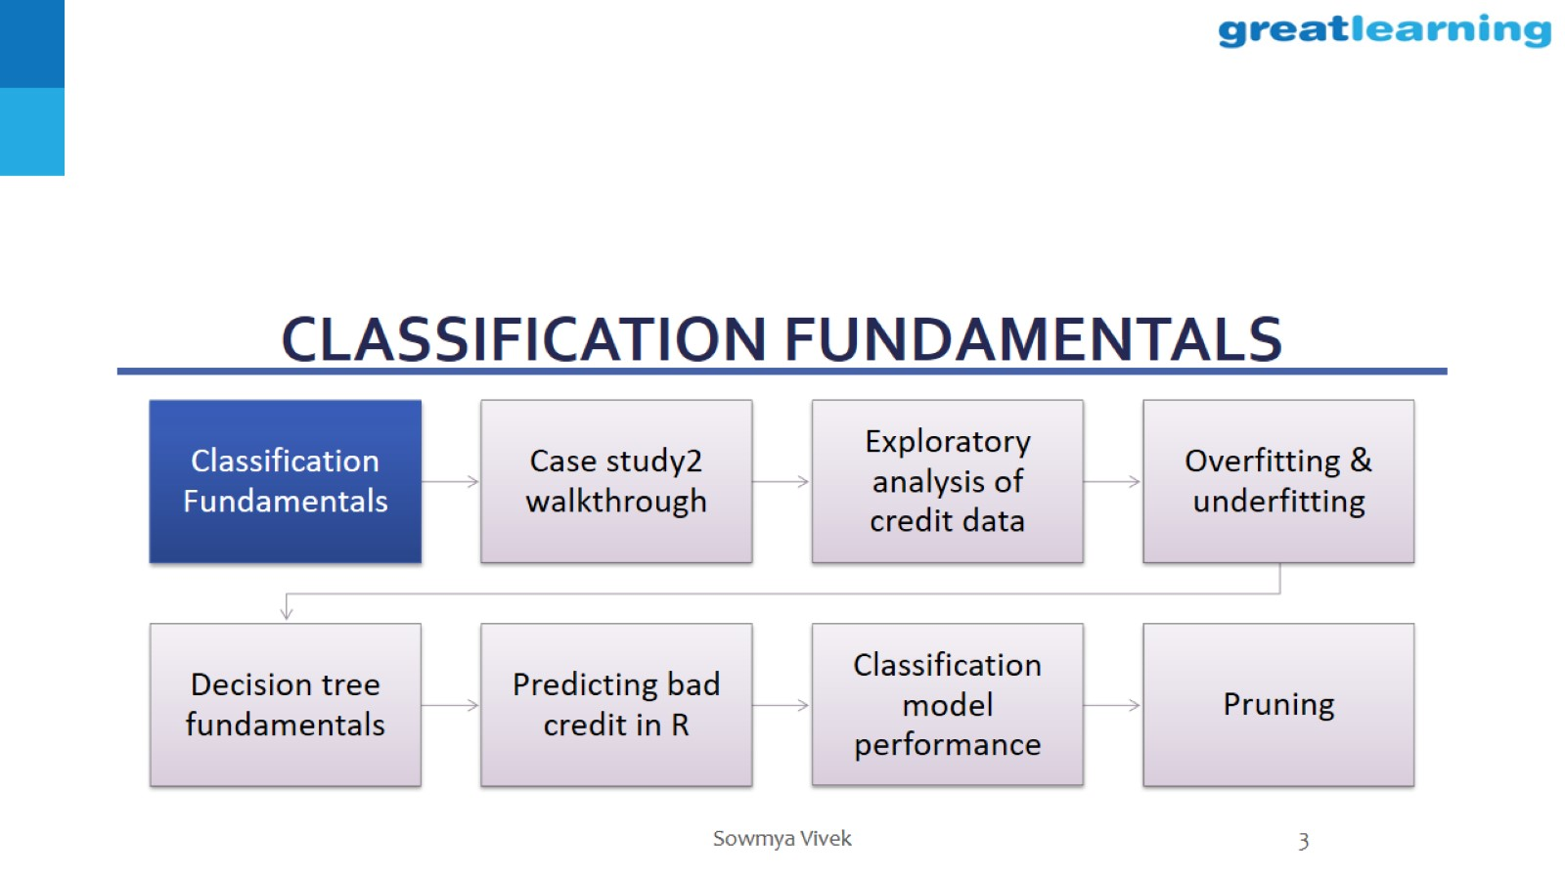
Classification fundamentals

Slide 4
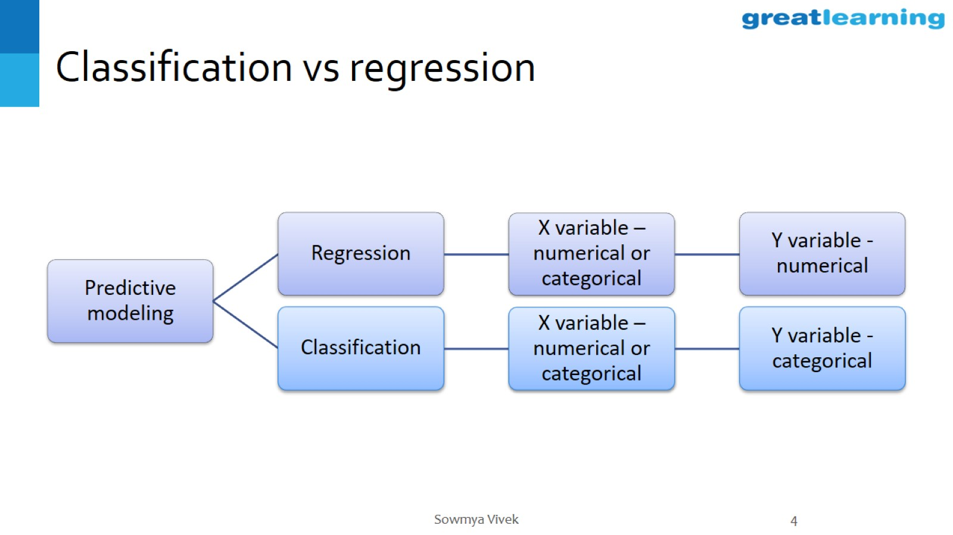
Classification vs regression

Slide 5
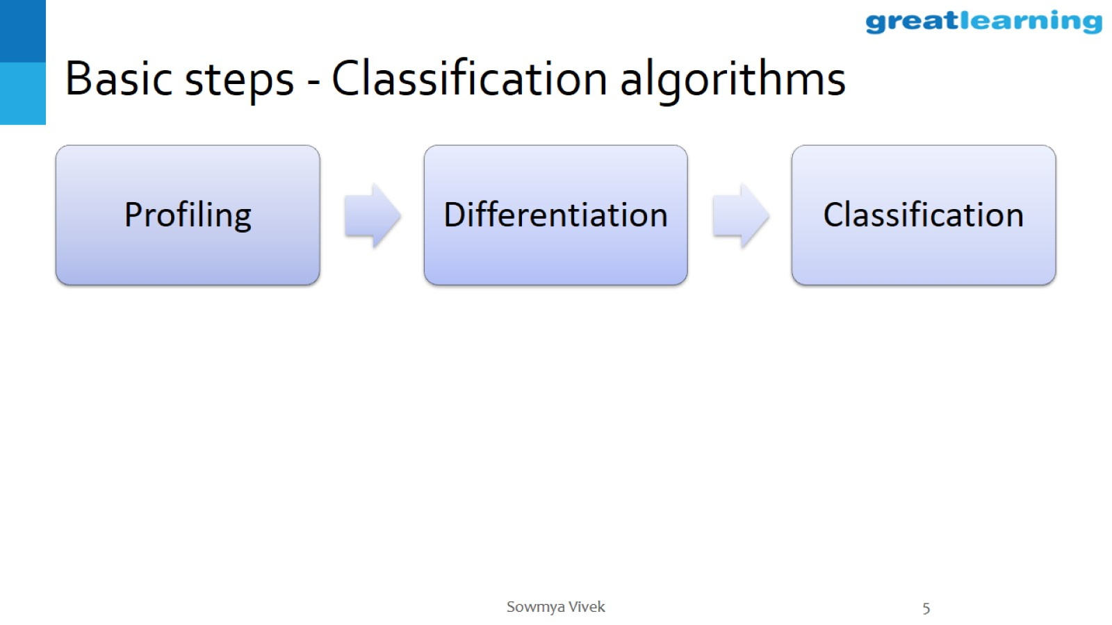
Basic steps - Classification algorithms

Slide 6
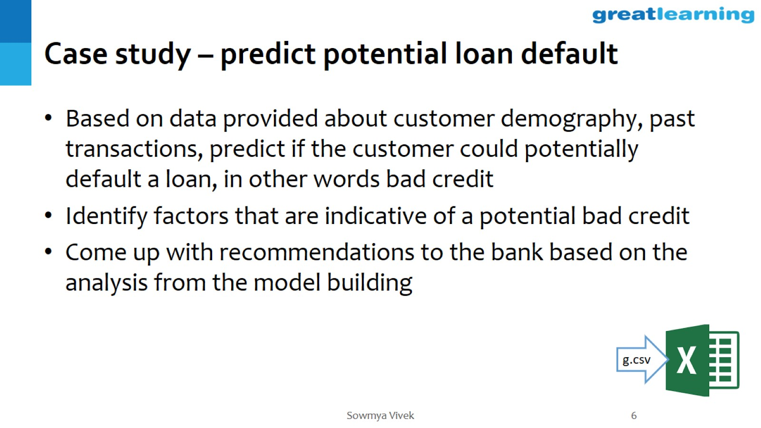
Case study – predict potential loan default

Slide 7
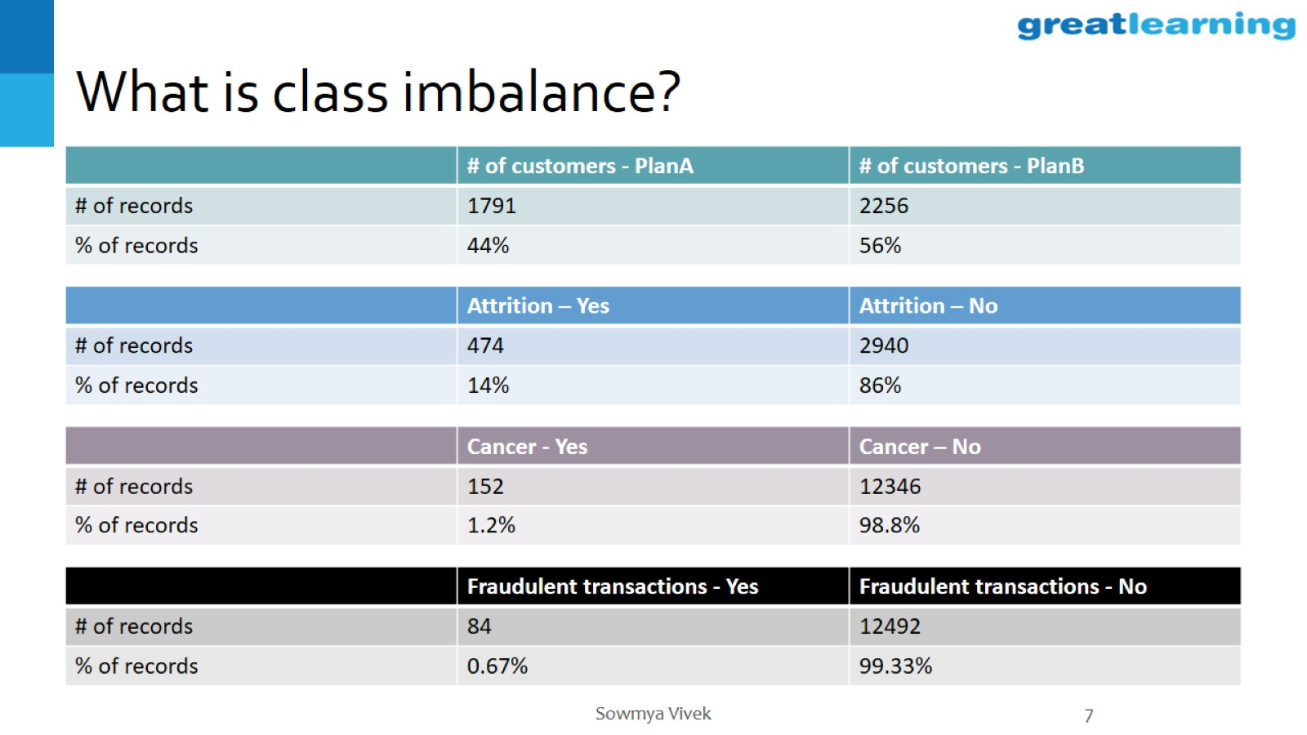
What is class imbalance?

Slide 8
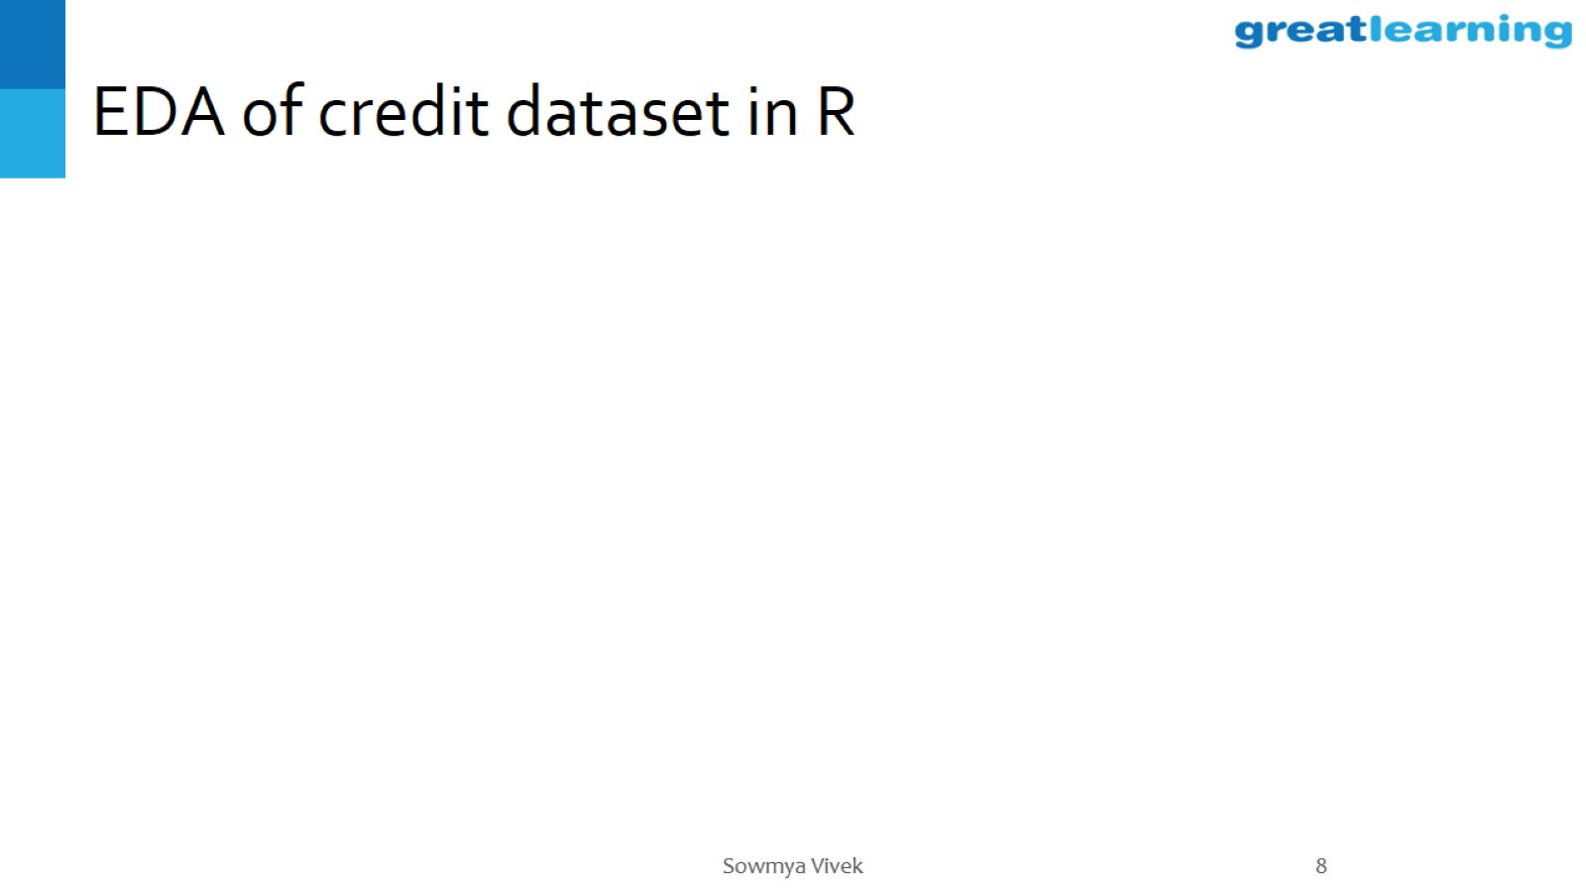
EDA of credit dataset in R

Slide 9
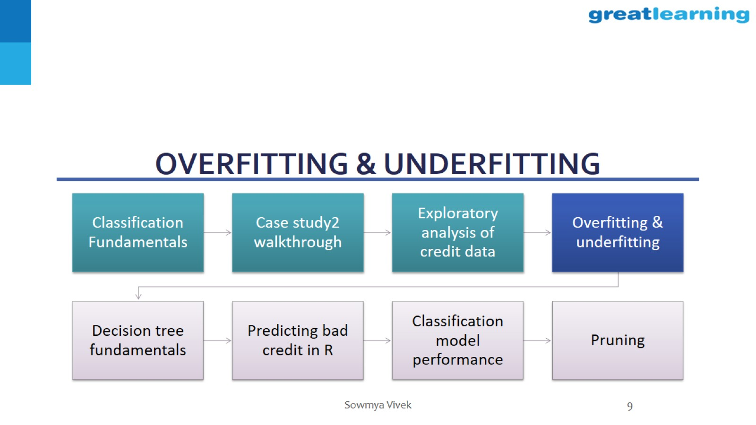
Overfitting & underfitting

Slide 10
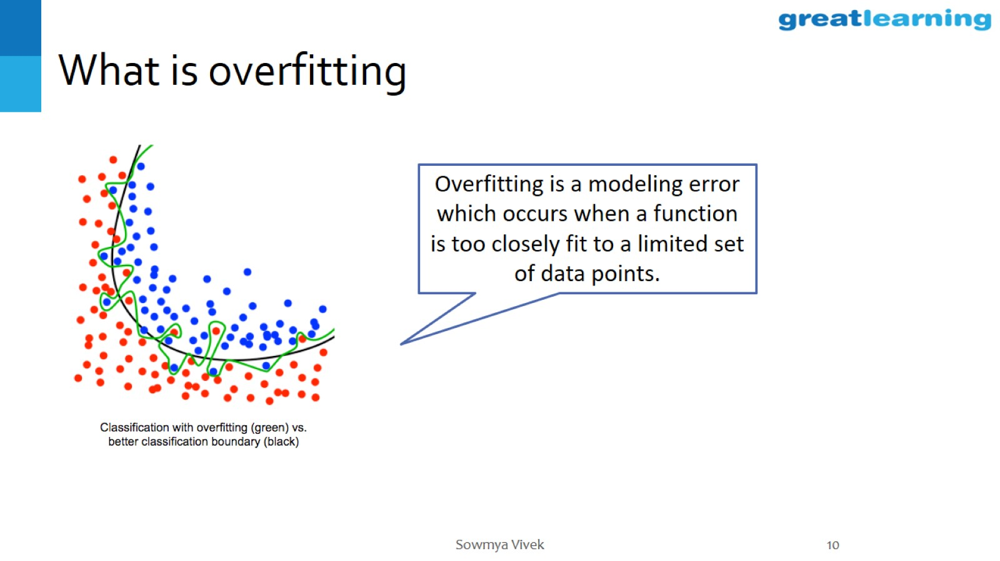
What is overfitting

Slide 11
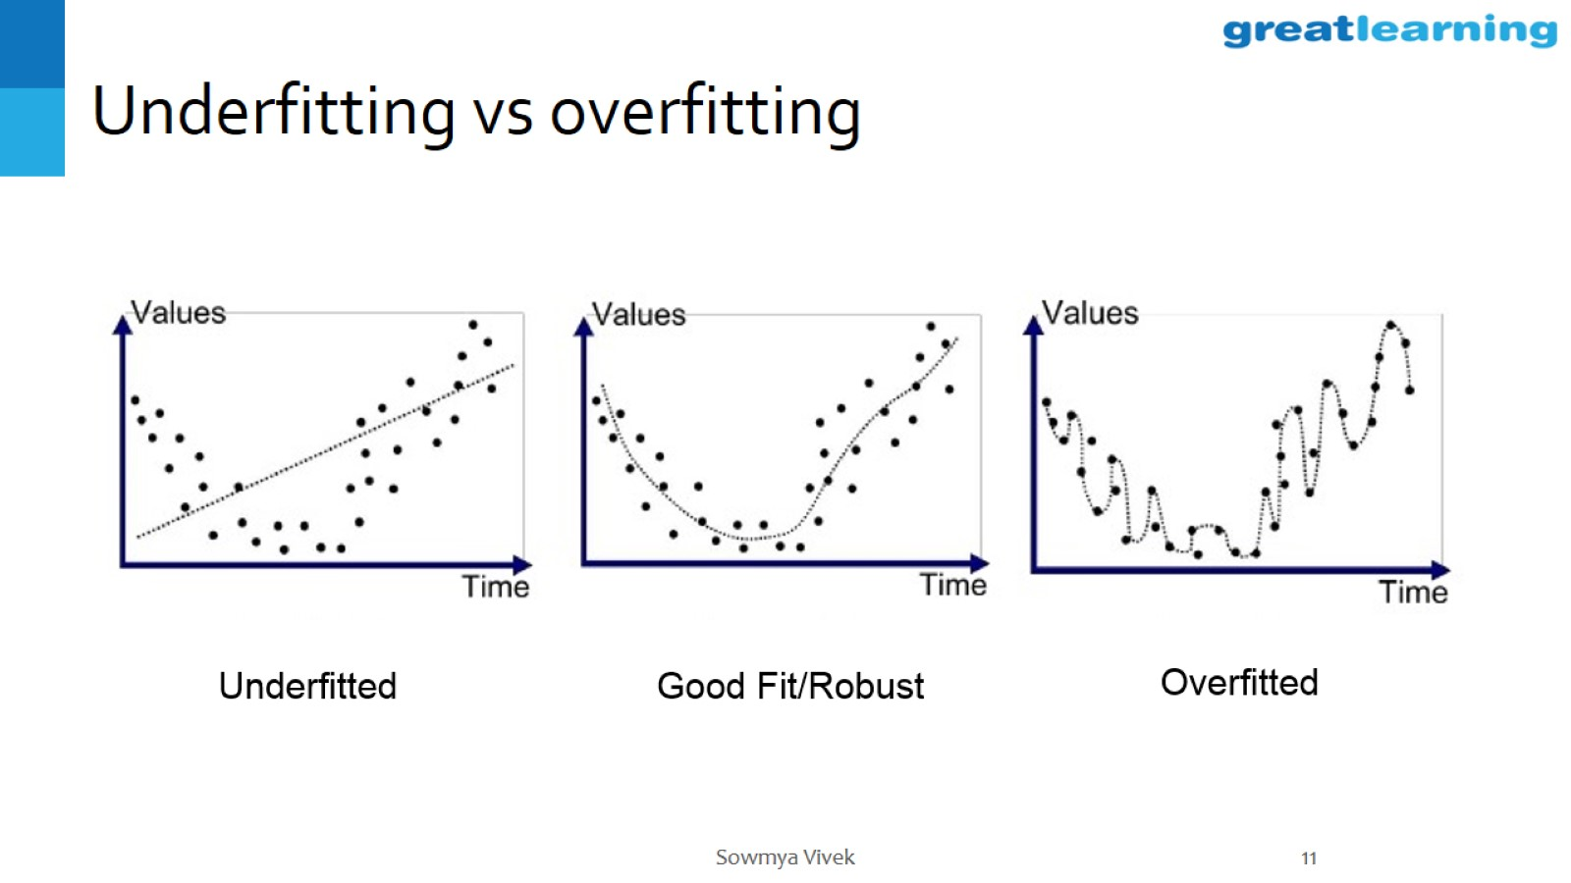
Underfitting vs overfitting

Slide 12
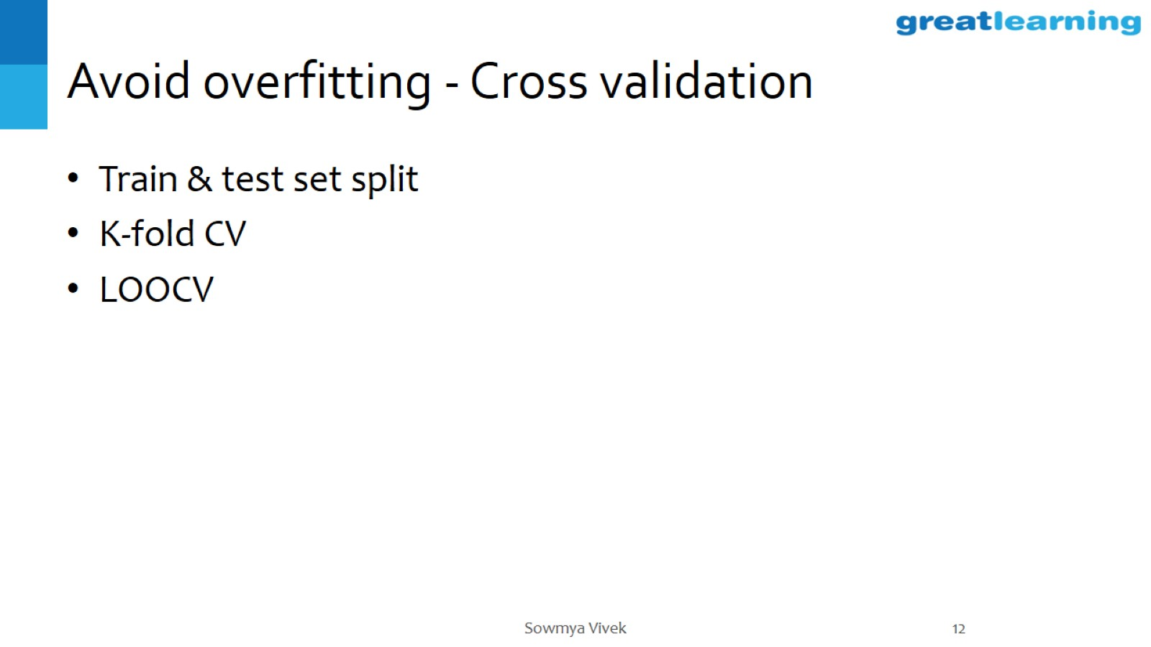
Avoid overfitting - Cross validation

Slide 13
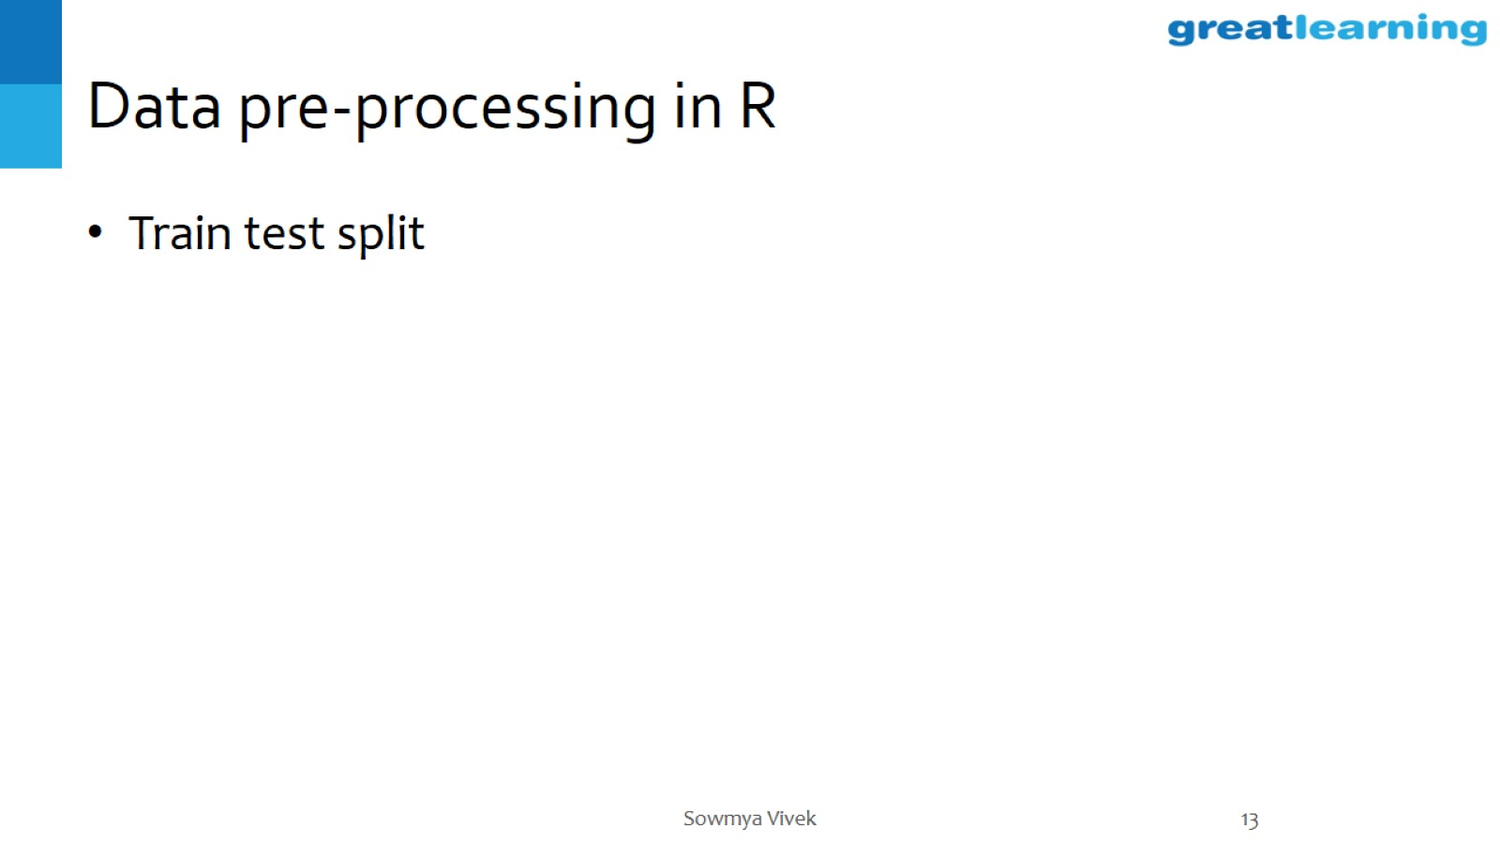
Data pre-processing in R

Slide 14
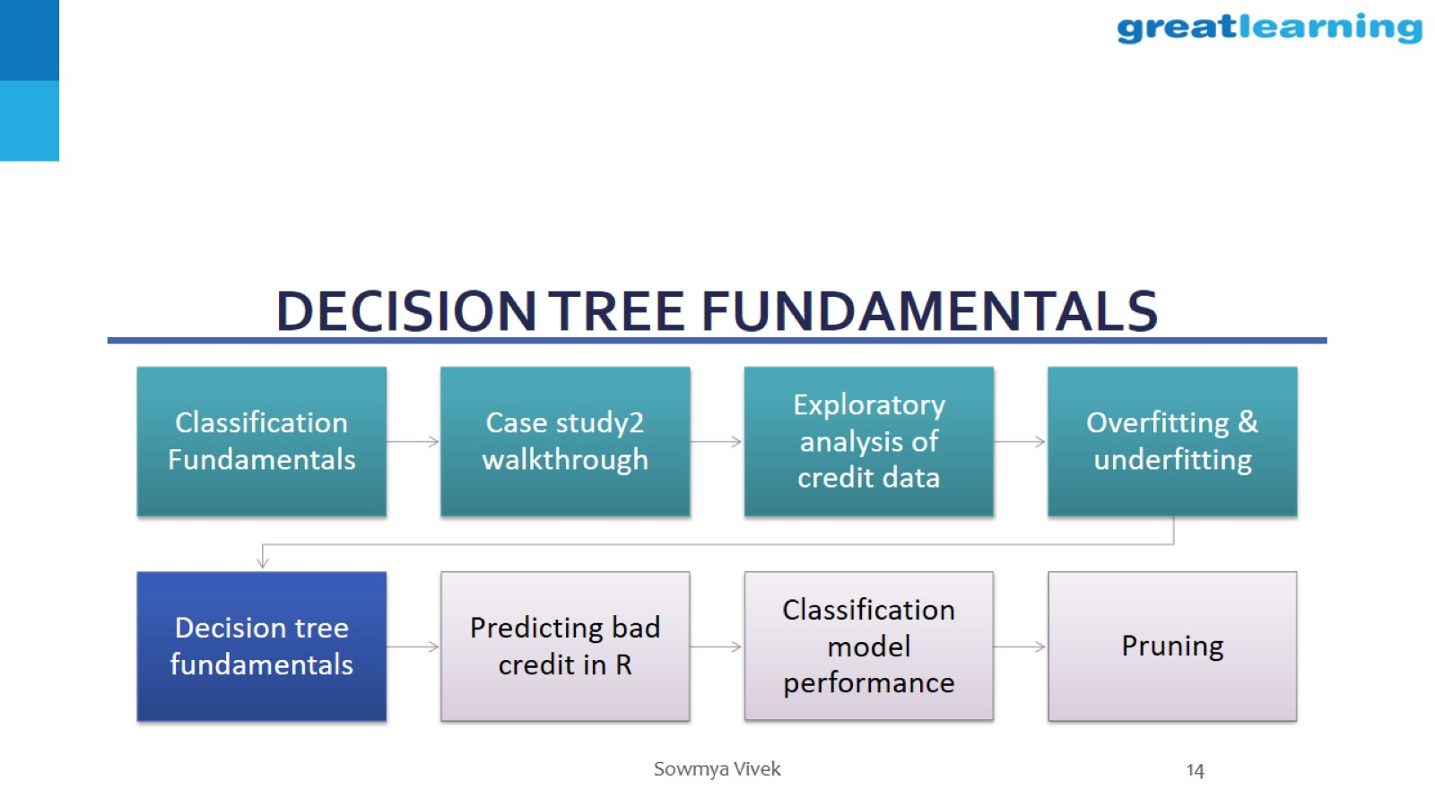
Decision tree fundamentals

Slide 15
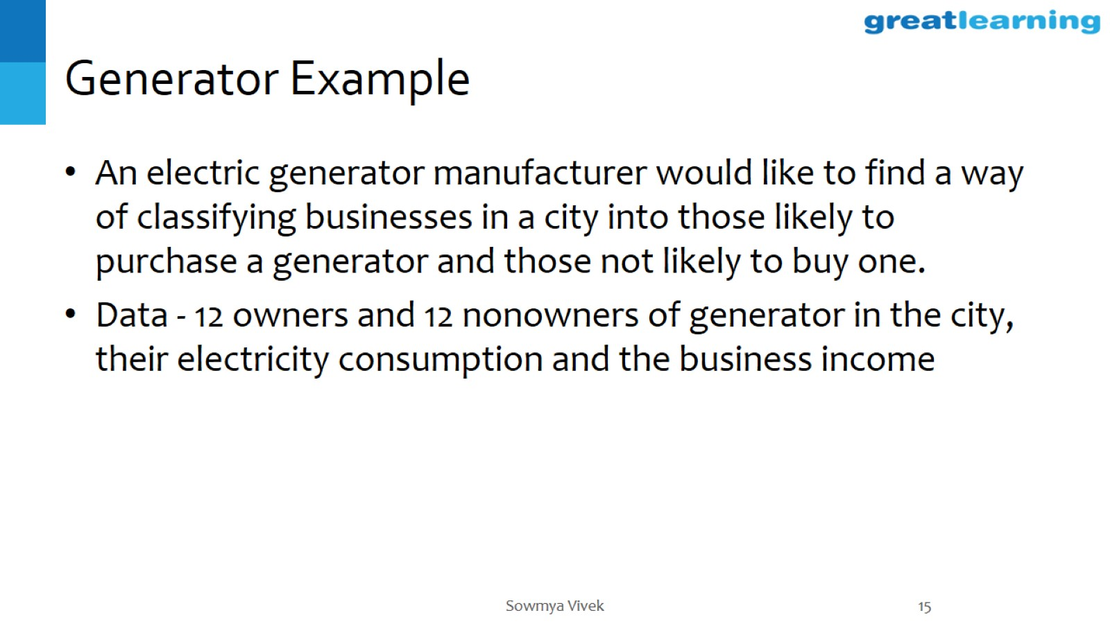
Generator Example

Slide 16
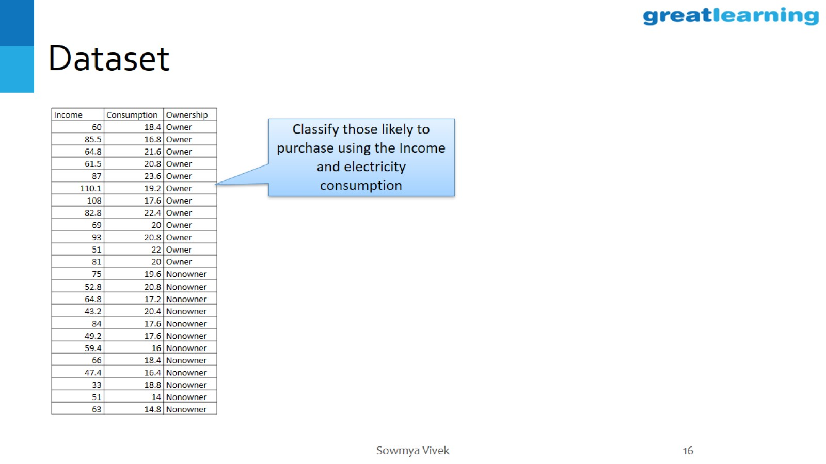
Dataset

Slide 17
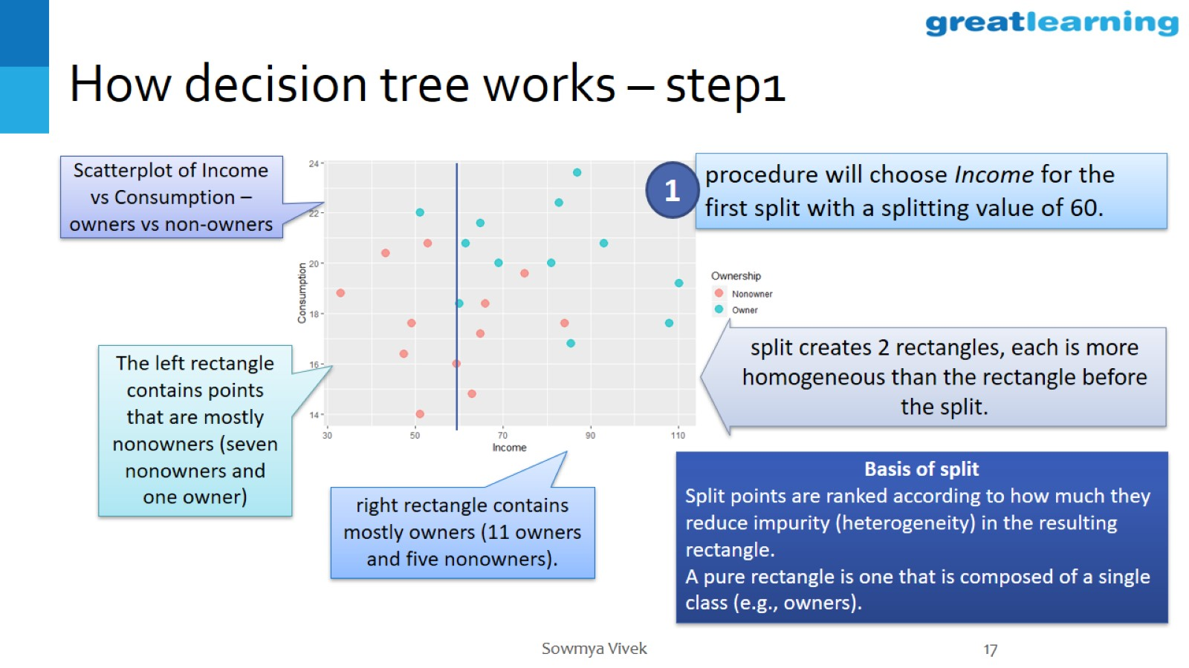
How decision tree works – step1

Slide 18
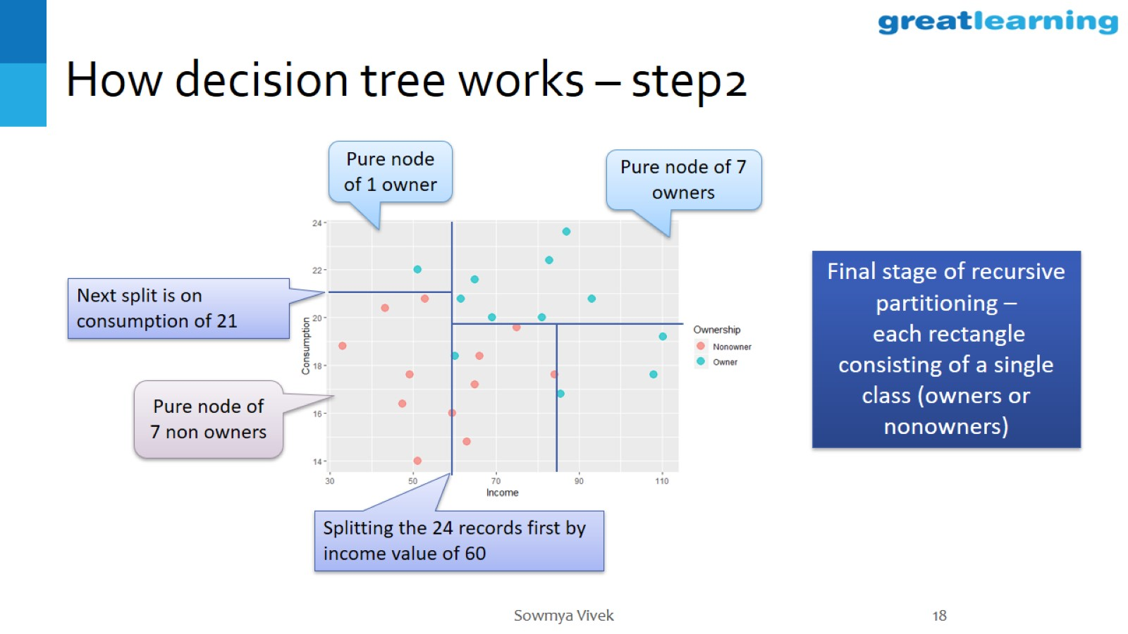
How decision tree works – step2

Slide 19
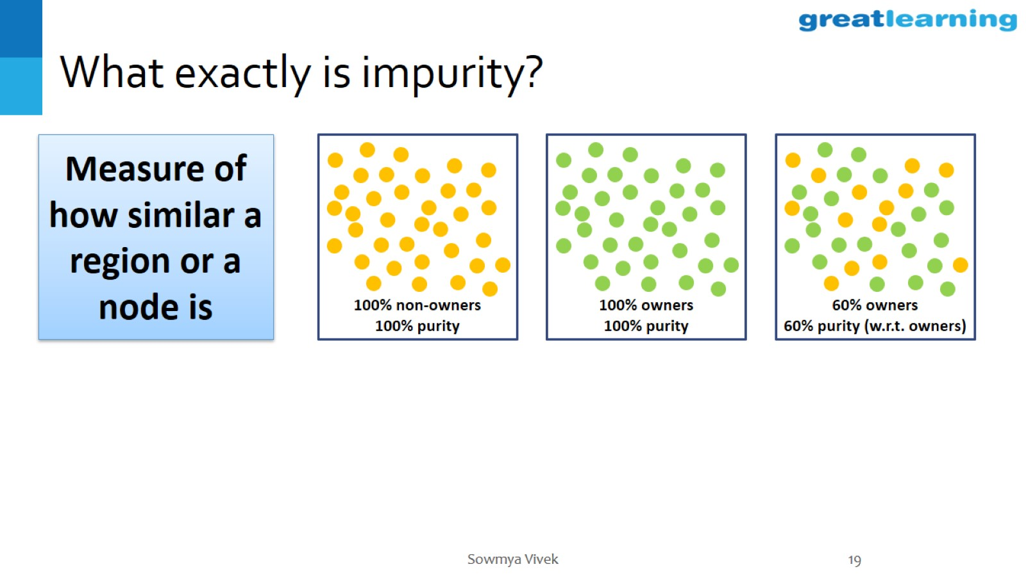
What exactly is impurity?

Slide 20
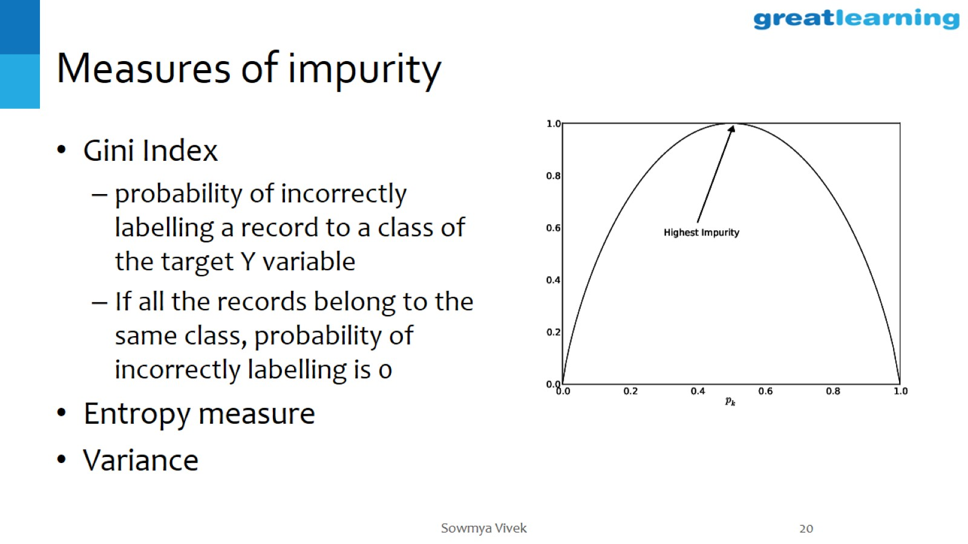
Measures of impurity

Slide 21
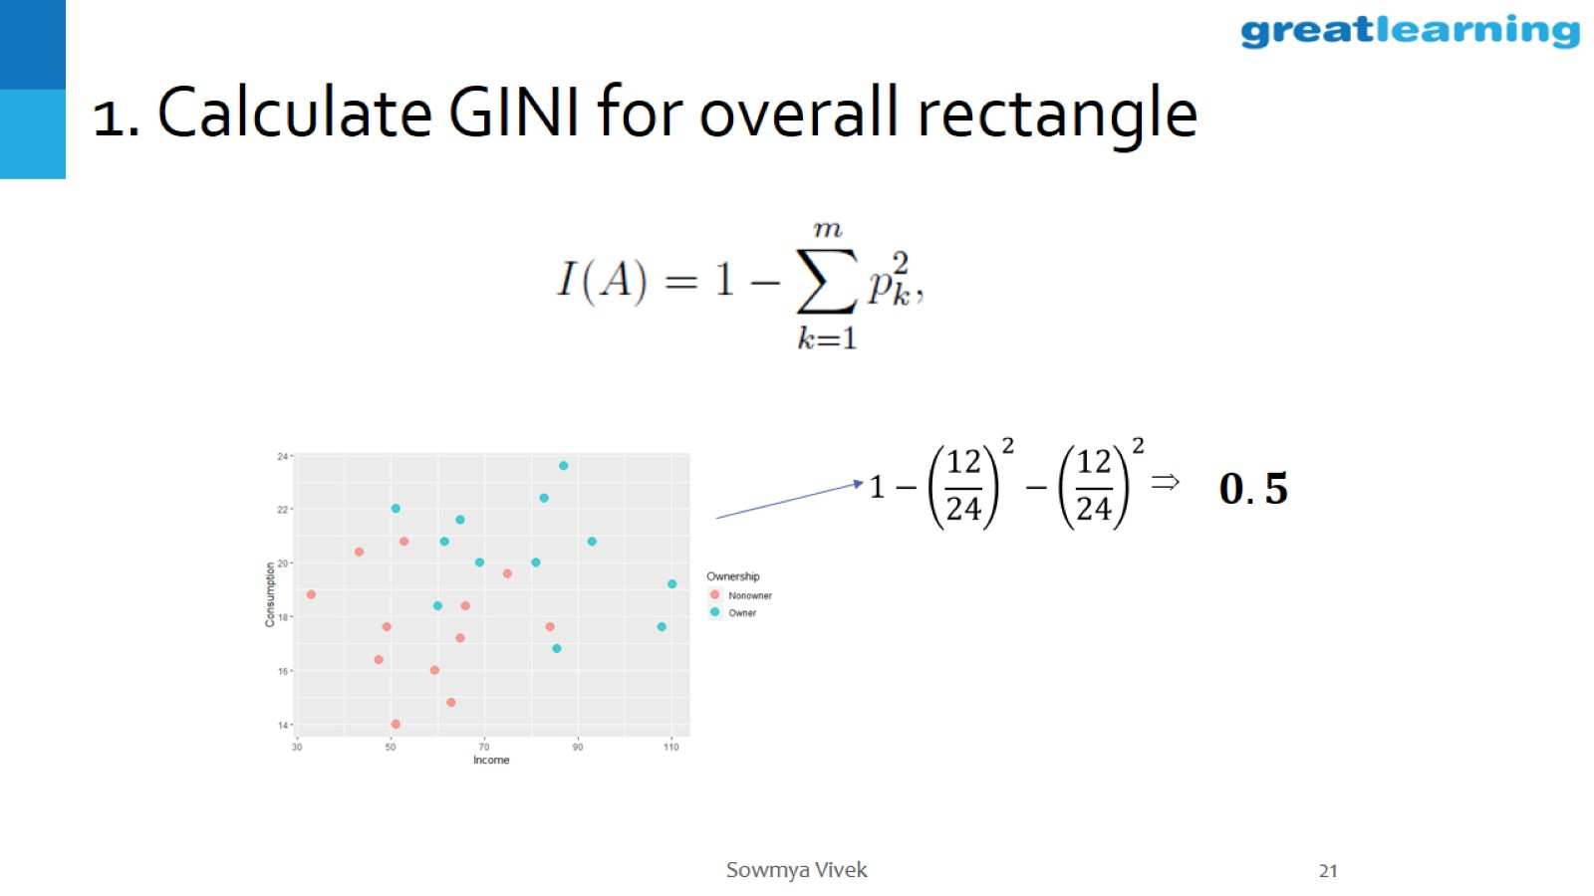
1. Calculate GINI for overall rectangle

Slide 22
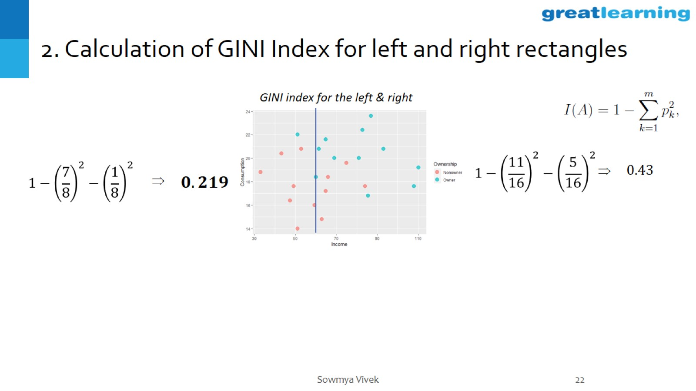
2. Calculation of GINI Index for left and right rectangles

Slide 23
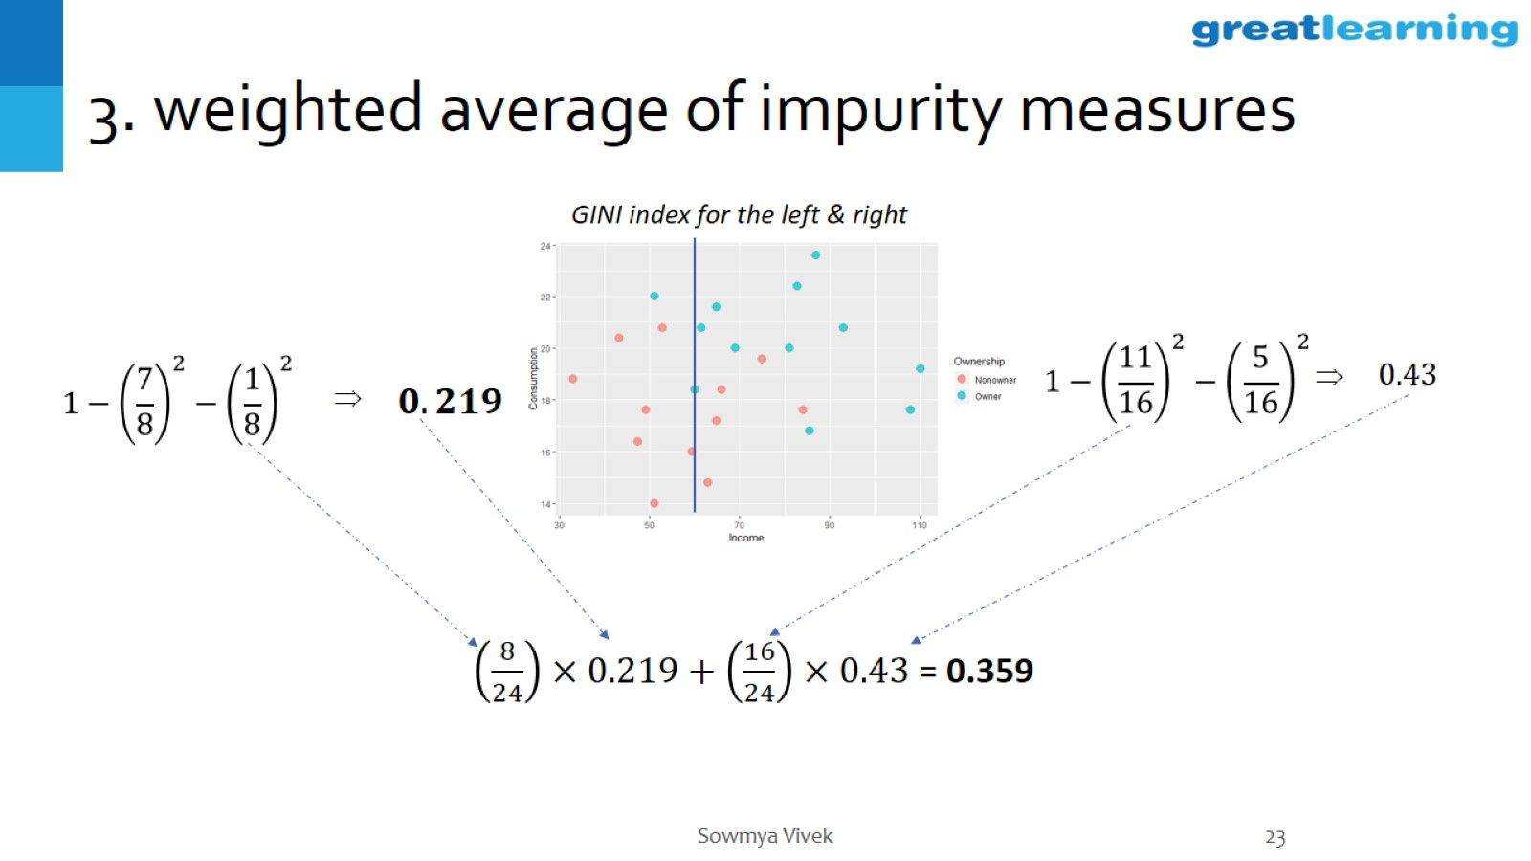
3. weighted average of impurity measures

Slide 24
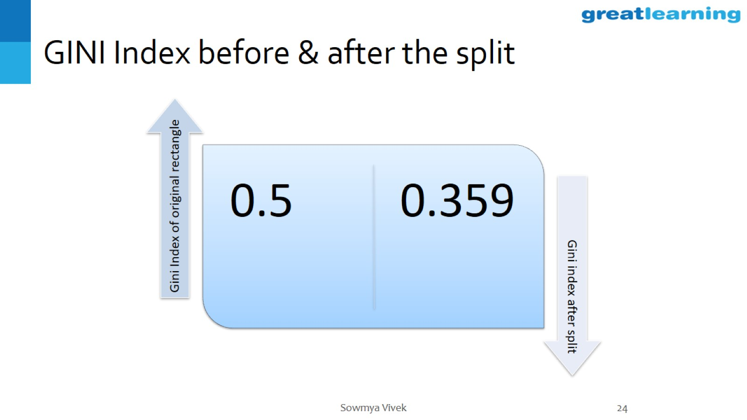
GINI Index before & after the split

Slide 25
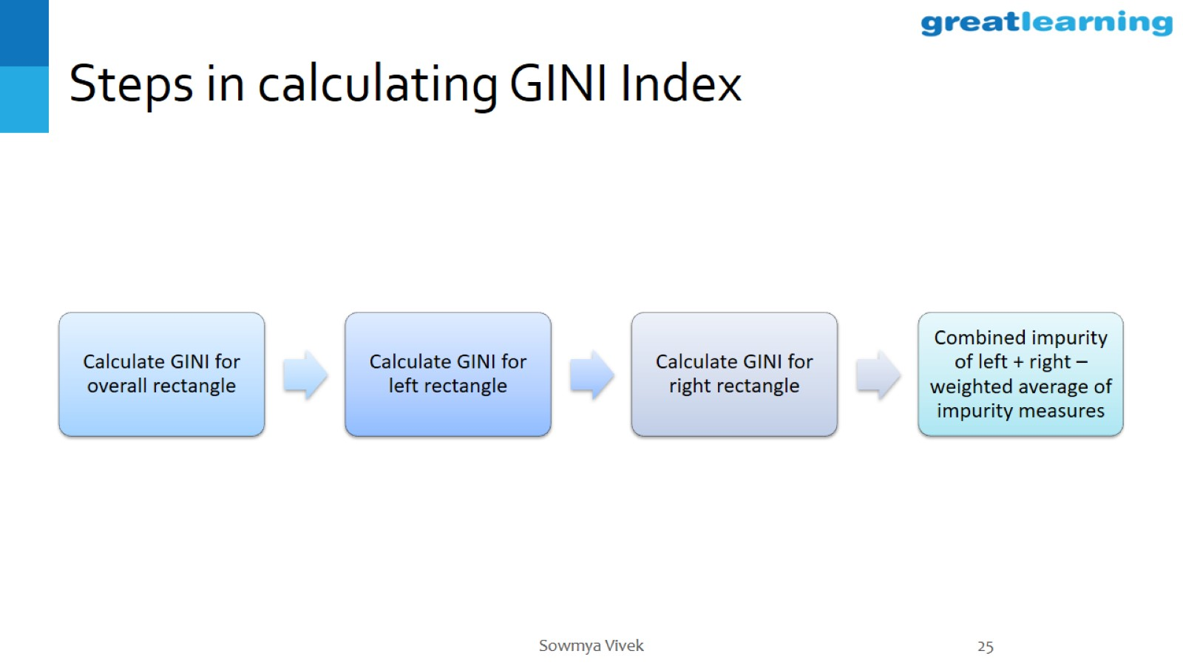
Steps in calculating GINI Index

Slide 26
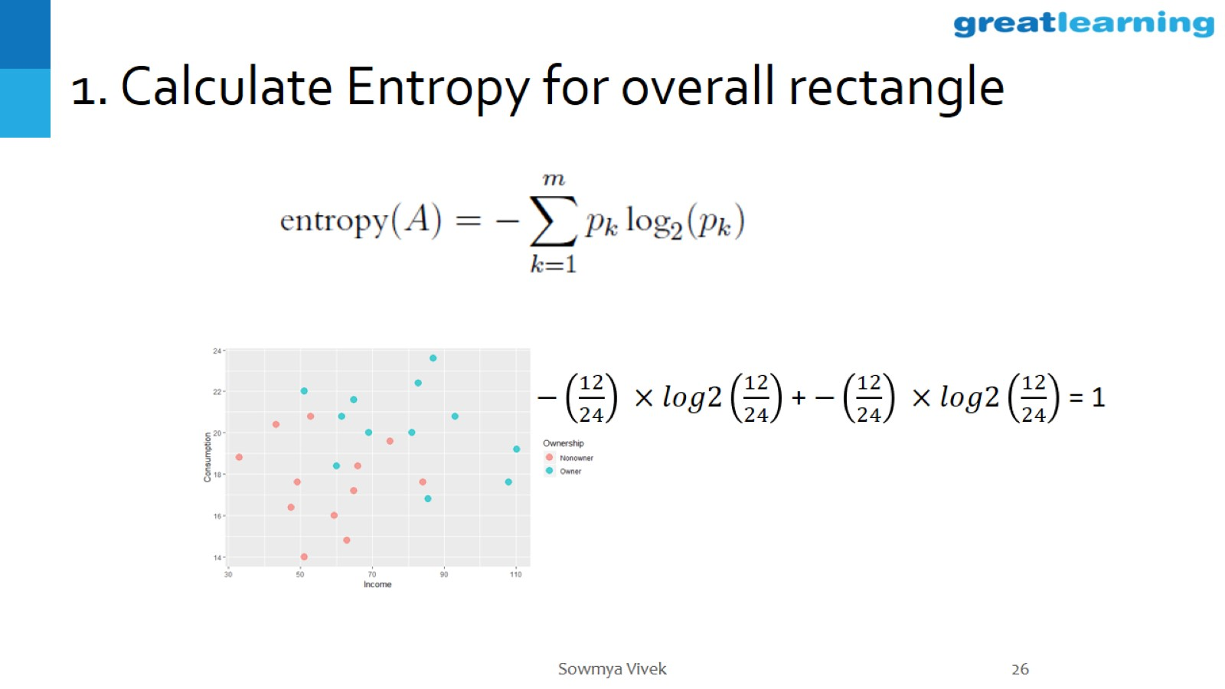
1. Calculate Entropy for overall rectangle

Slide 27
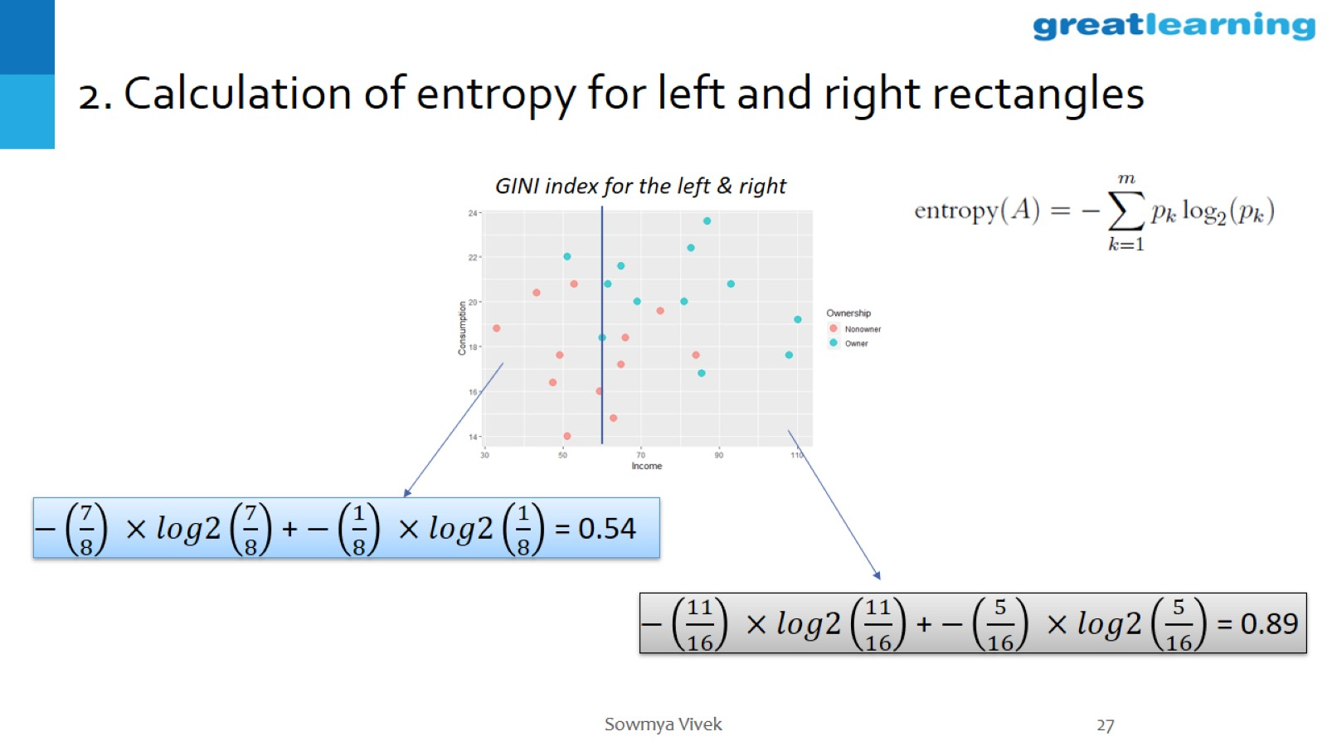
2. Calculation of entropy for left and right rectangles

Slide 28
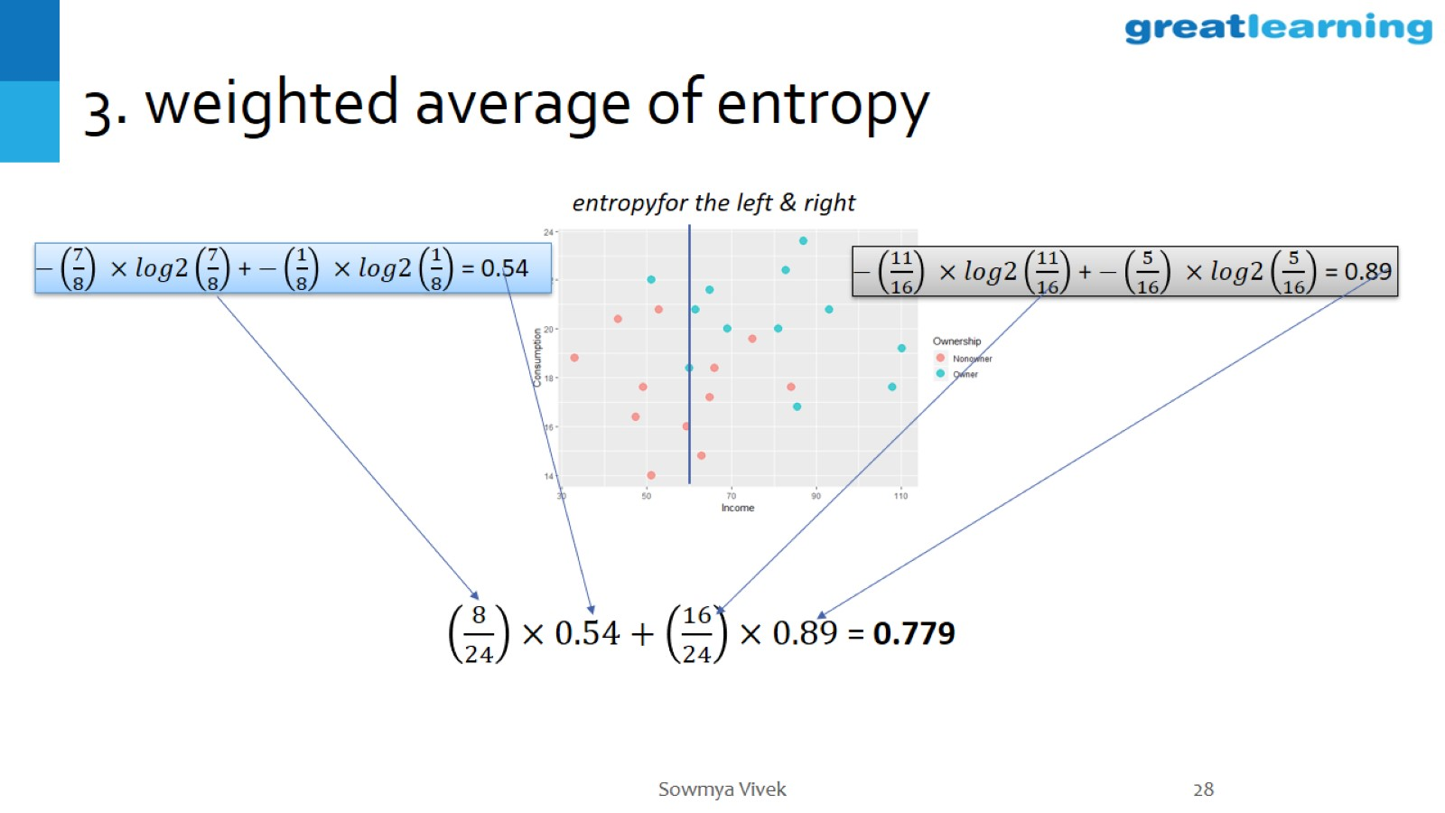
3. weighted average of entropy

Slide 29
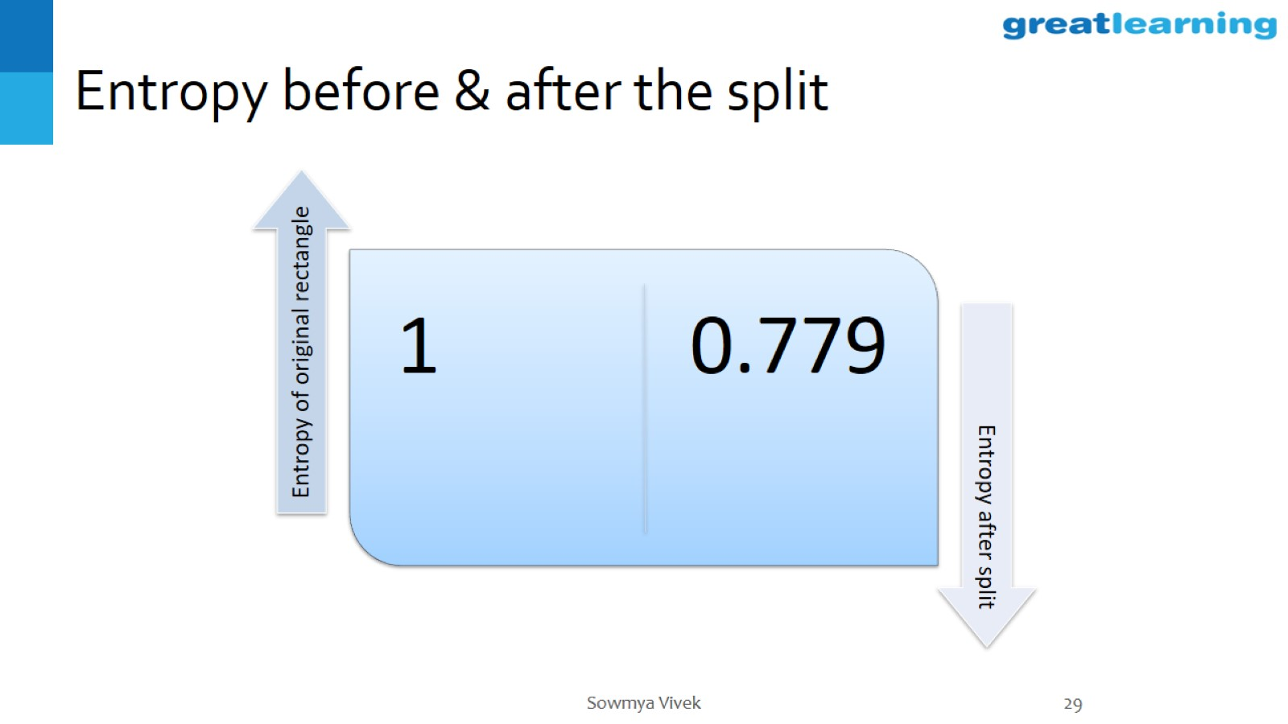
Entropy before & after the split

Slide 30
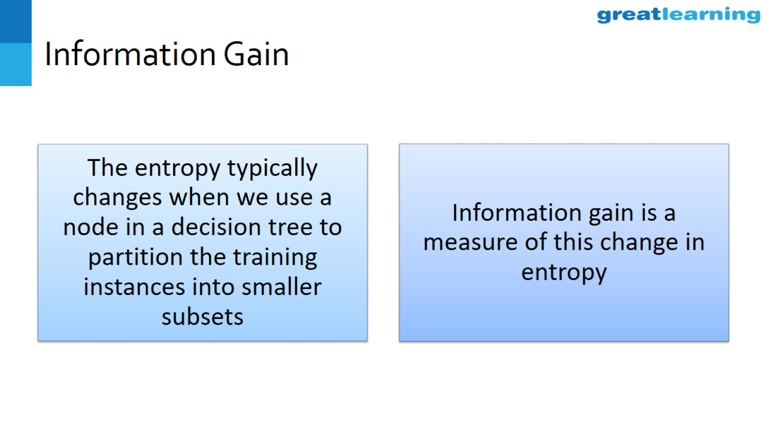
Information Gain

Slide 31
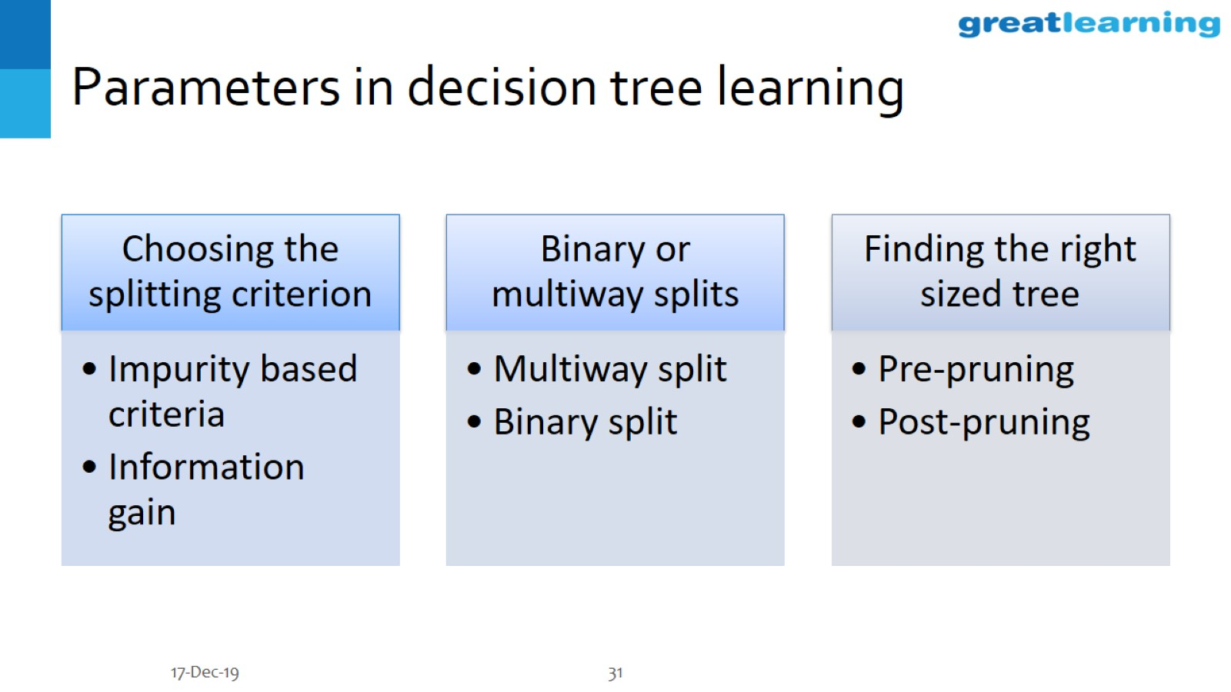
Parameters in decision tree learning

Slide 32
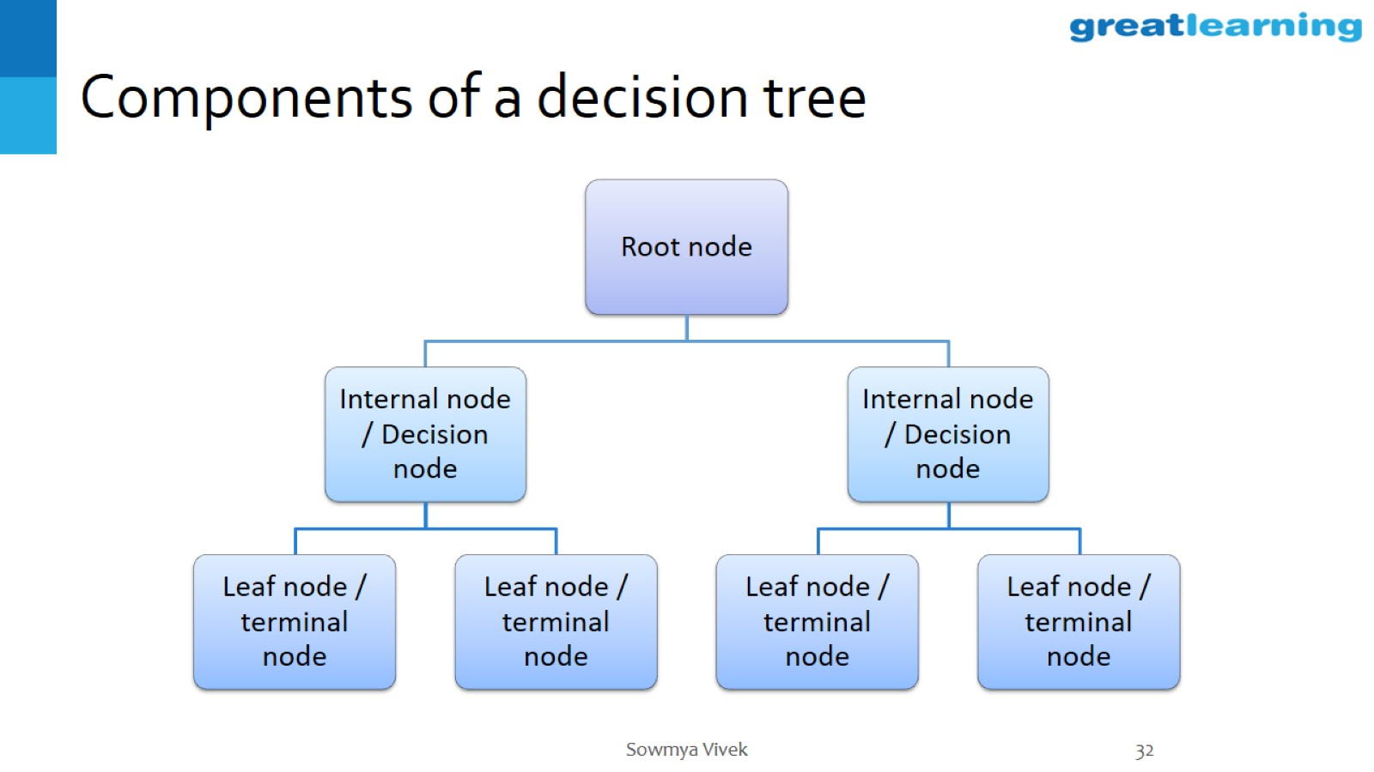
Components of a decision tree

Slide 33
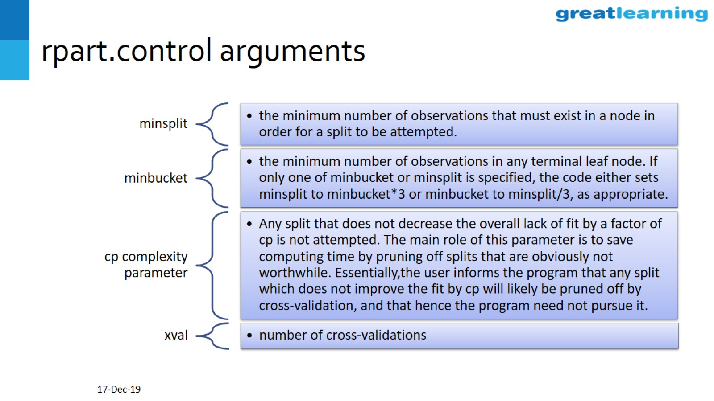
rpart.control arguments

Slide 34
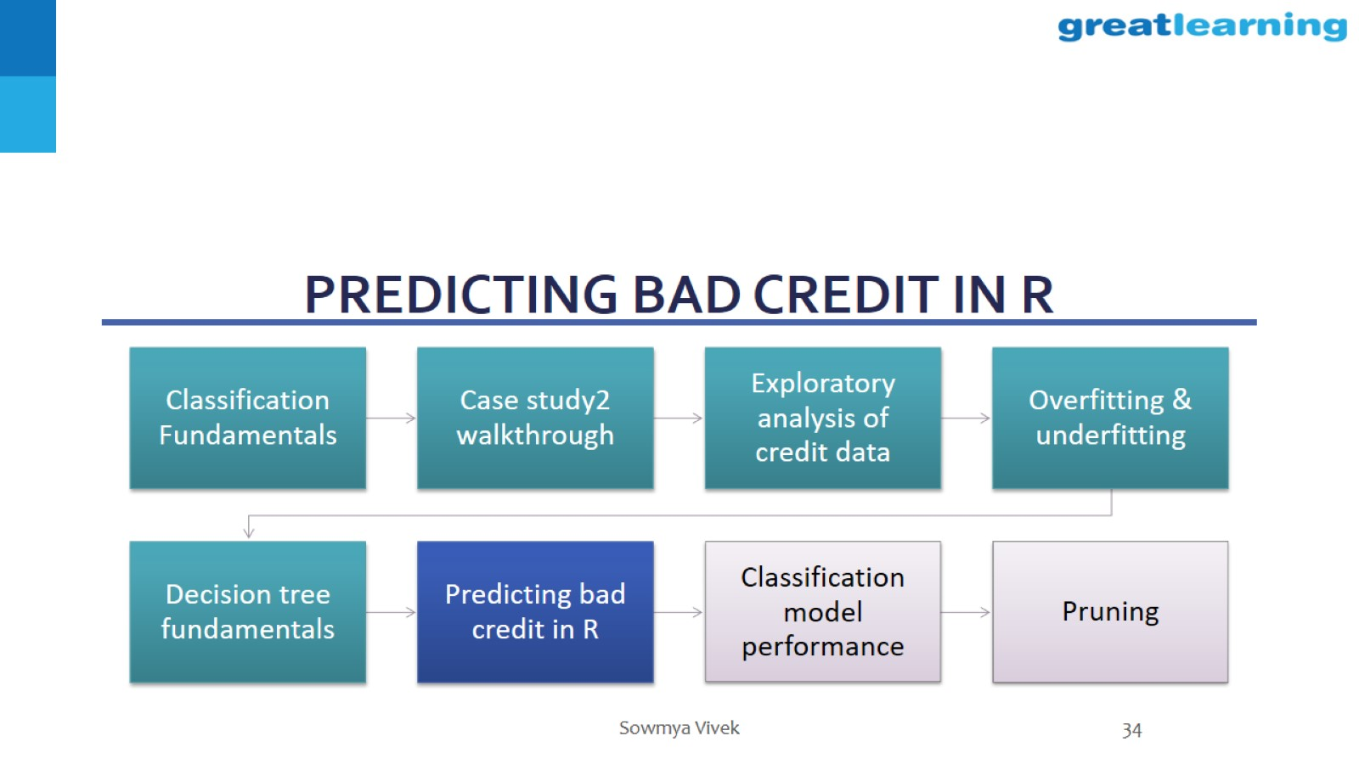
Predicting bad credit in R

Slide 35
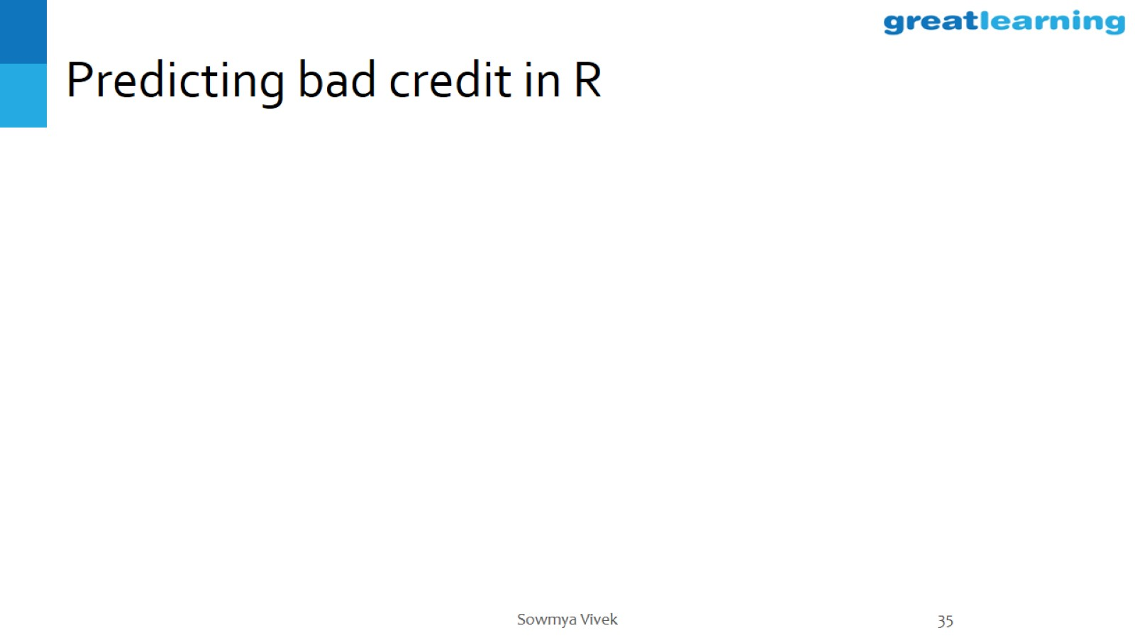
Predicting bad credit in R

Slide 36
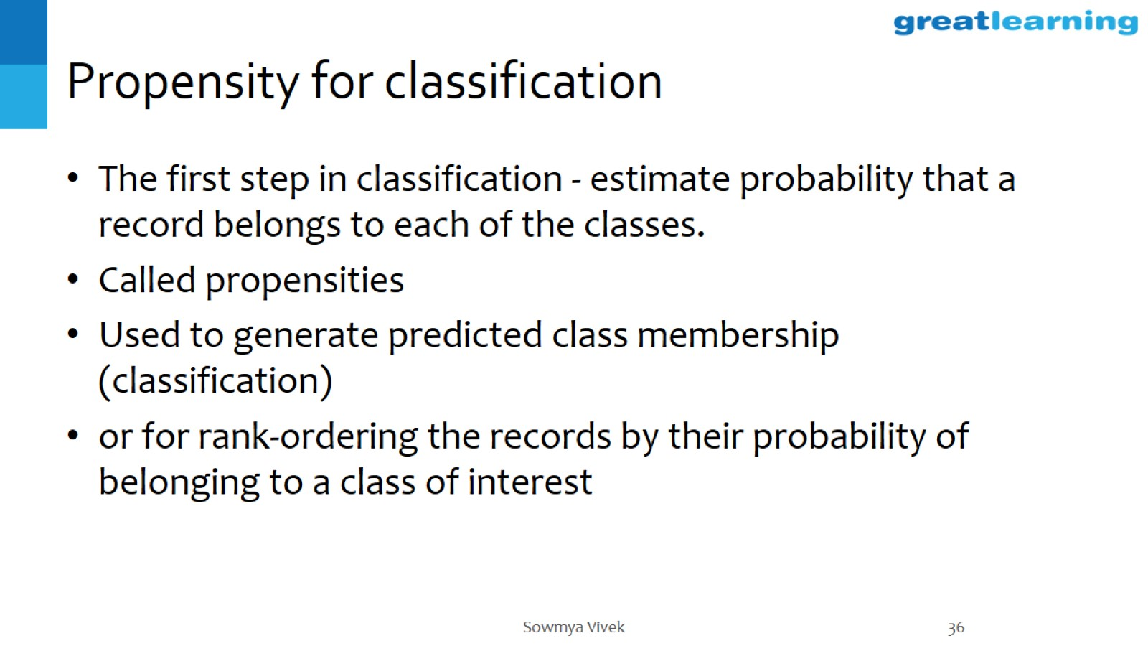
Propensity for classification

Slide 37
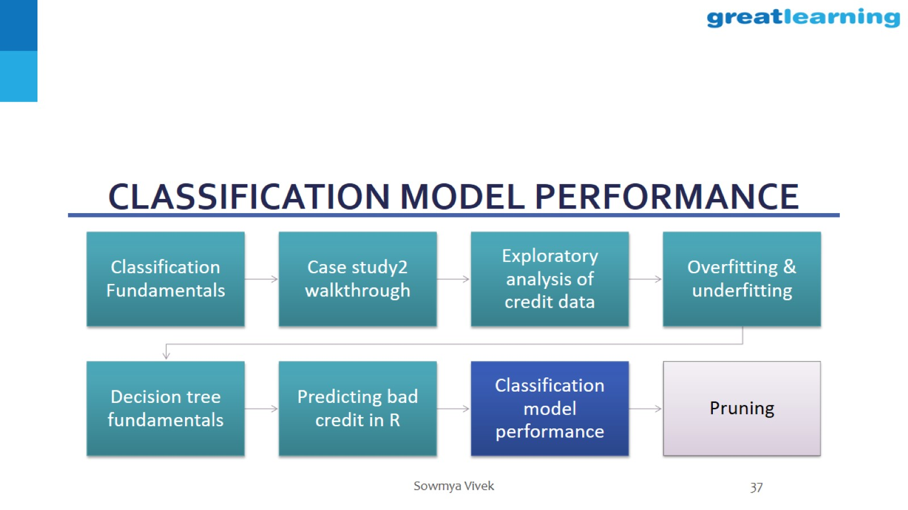
Classification model performance

Slide 38
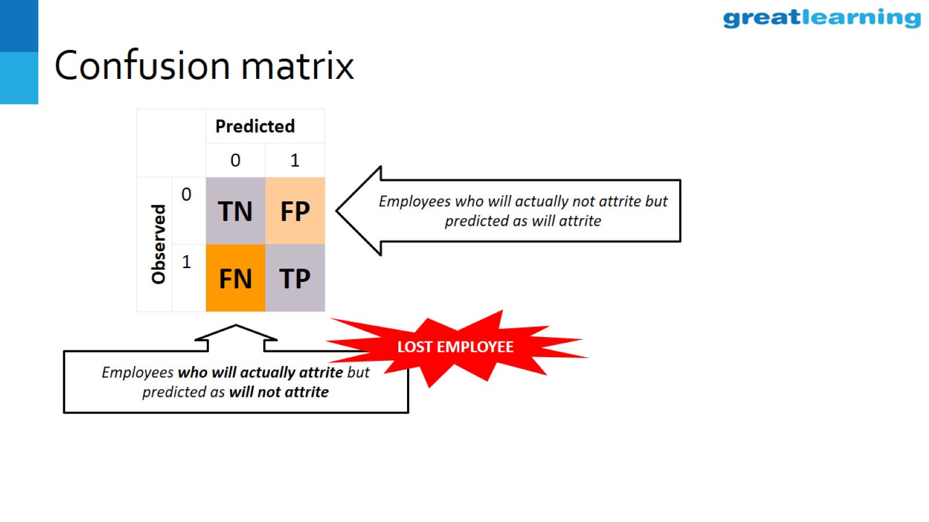
Confusion matrix

Slide 39
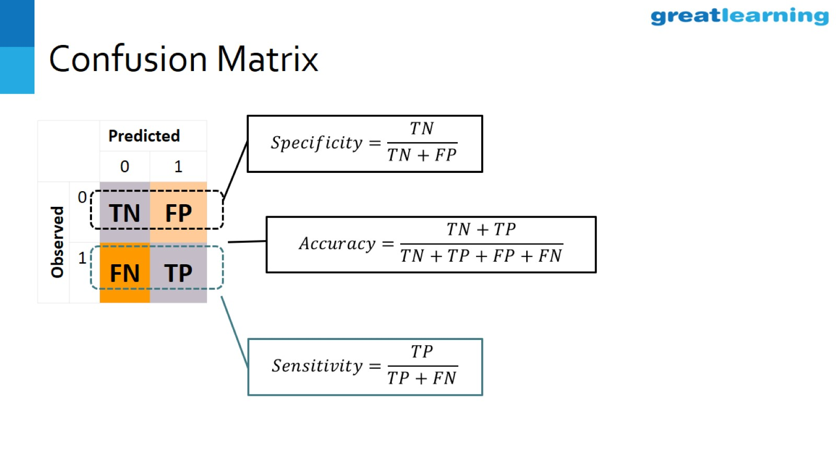
Confusion Matrix

Slide 40
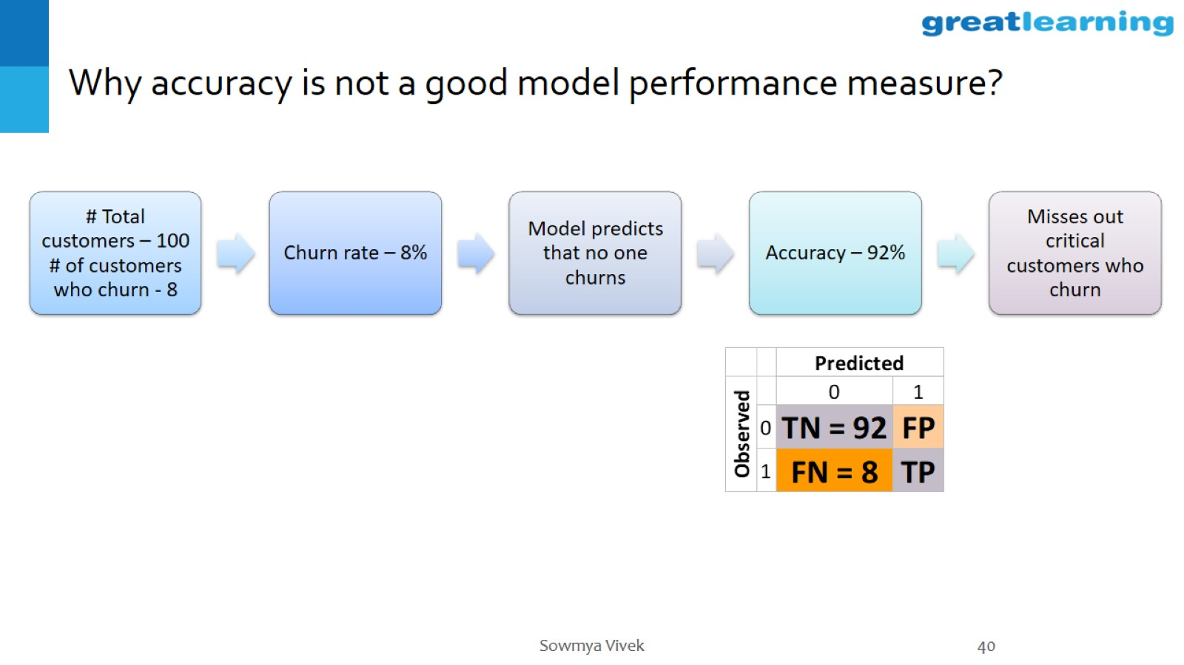
Why accuracy is not a good model performance measure?

Slide 41
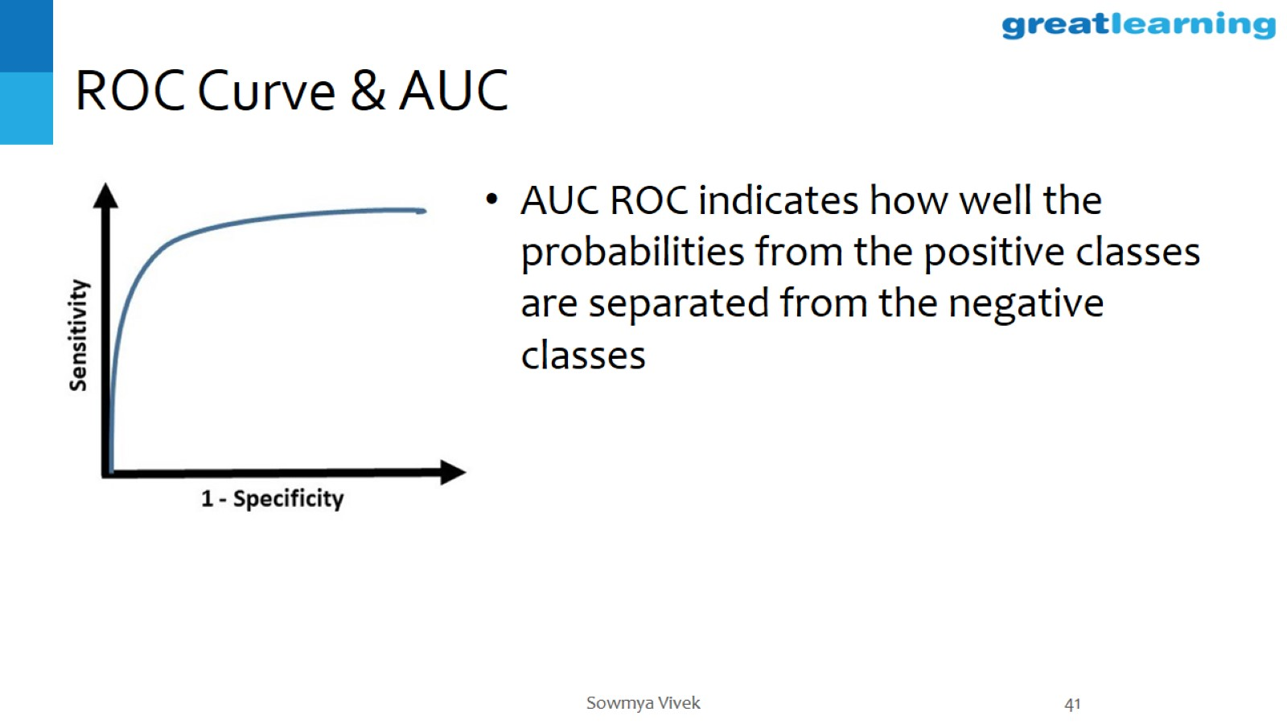
ROC Curve & AUC

Slide 42
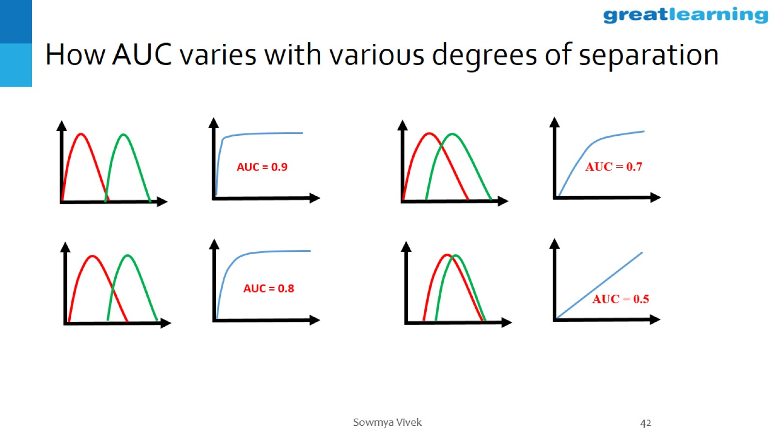
How AUC varies with various degrees of separation

Slide 43
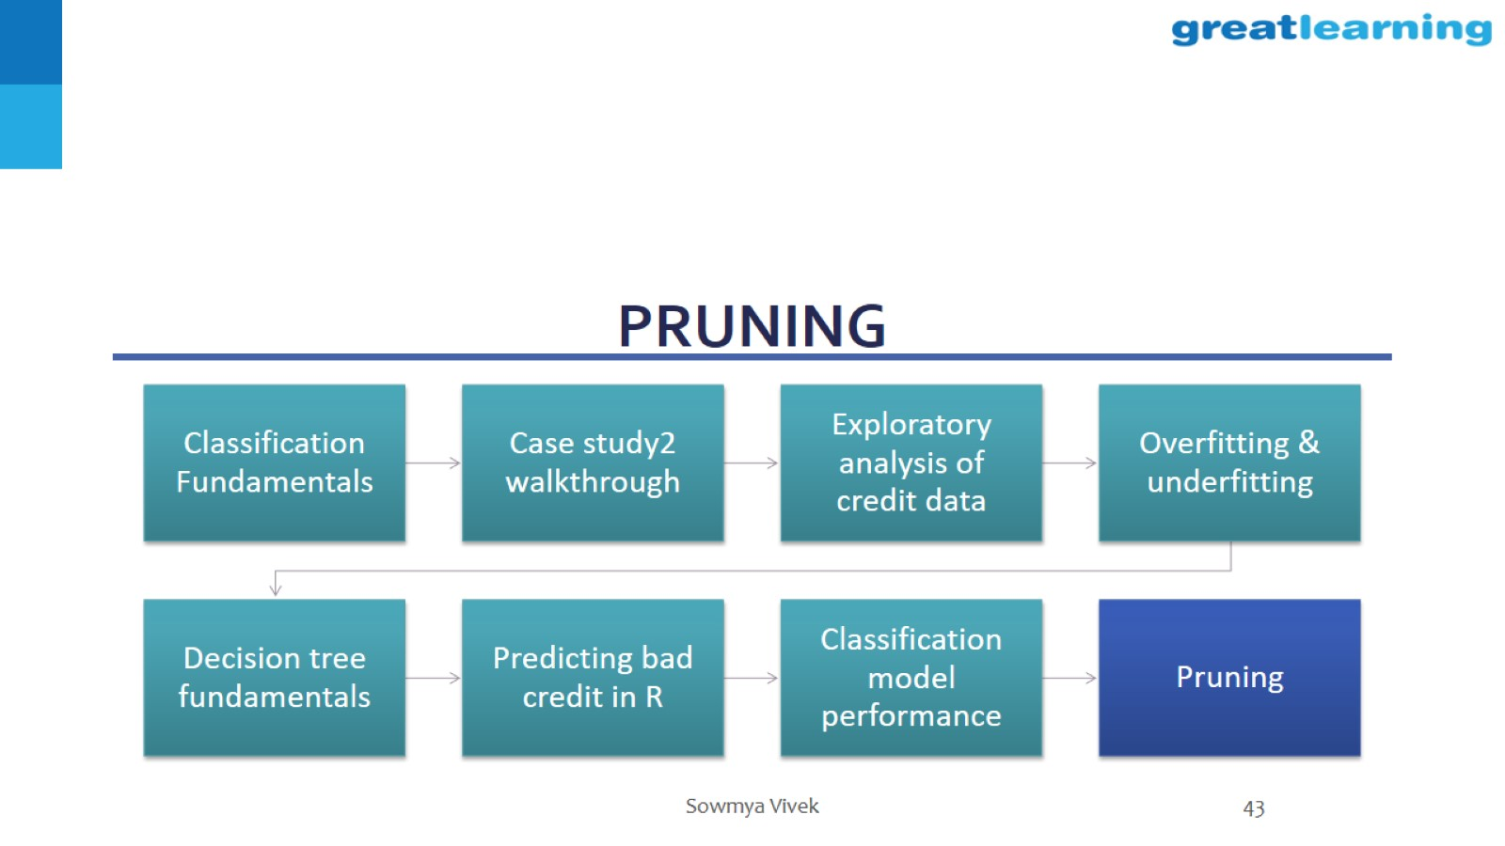
pruning

Slide 44
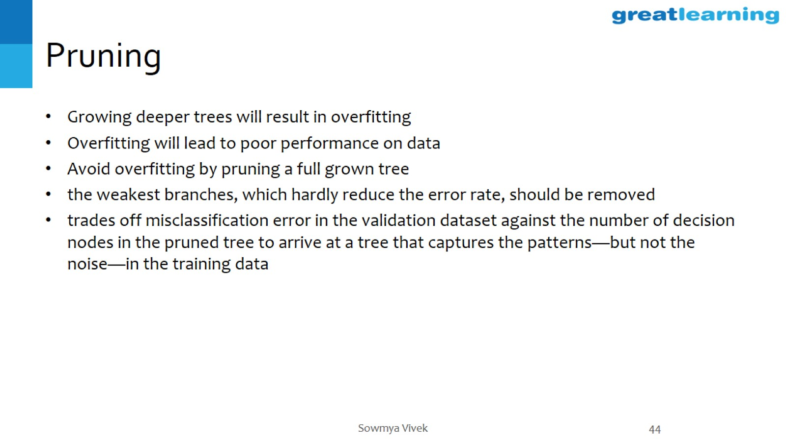
Pruning

Slide 45
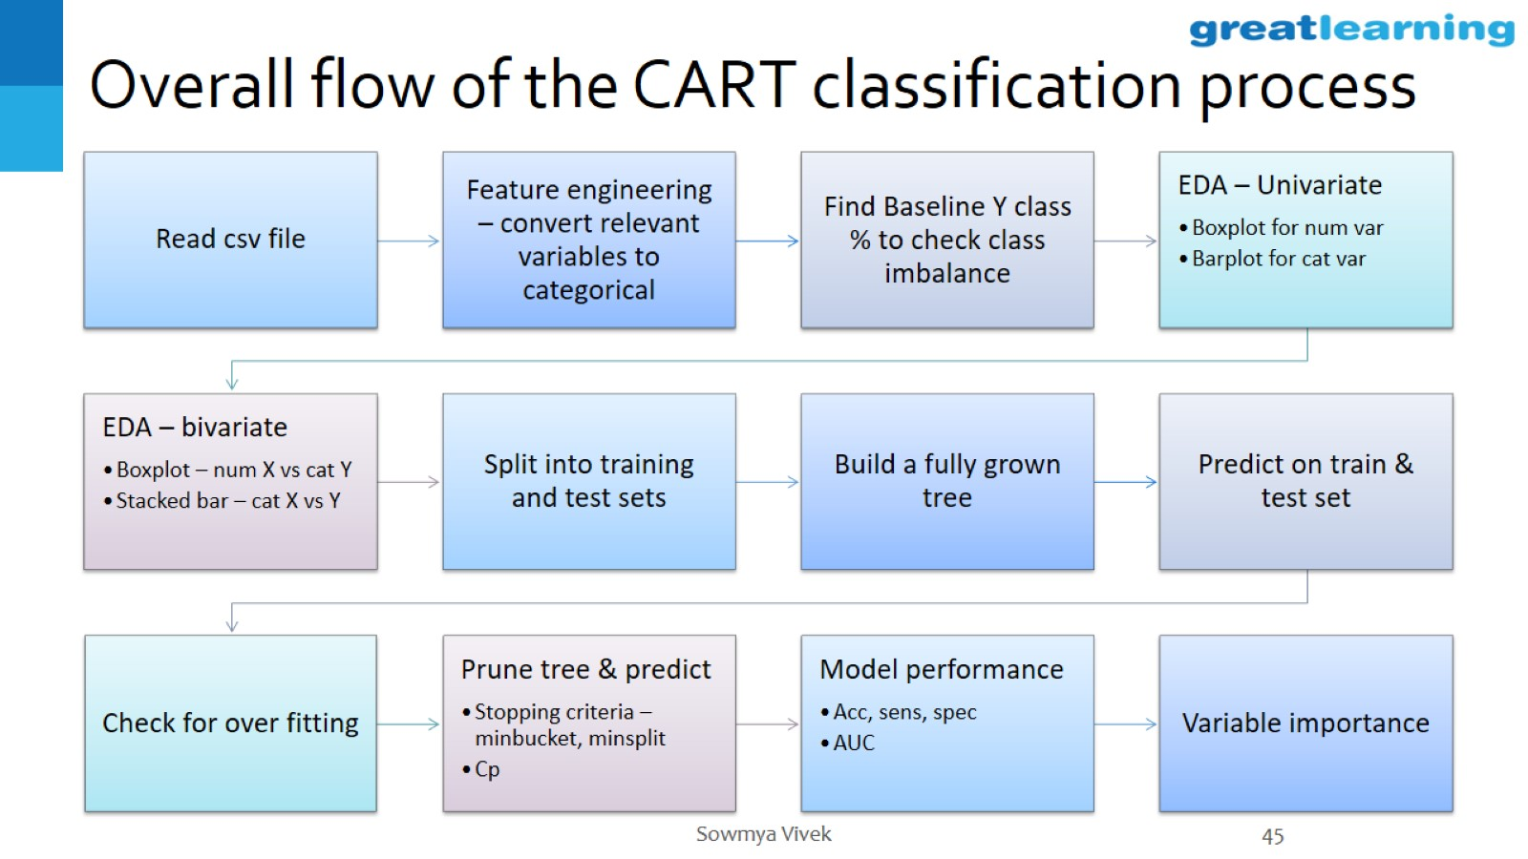
Overall flow of the CART classification process

Slide 46
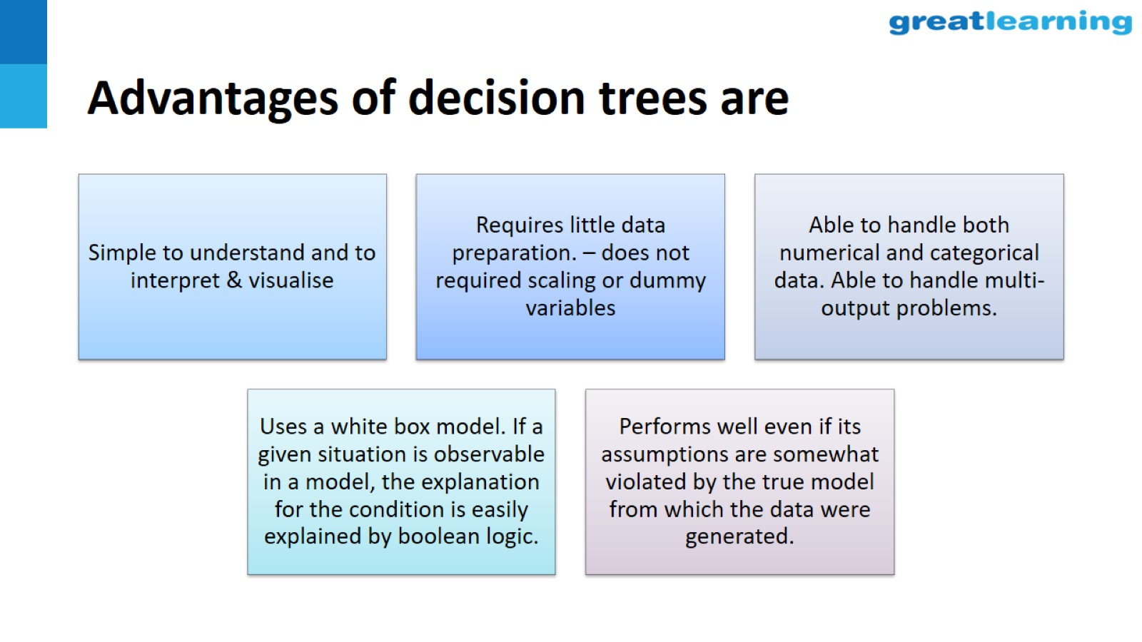
Advantages of decision trees are

Slide 47
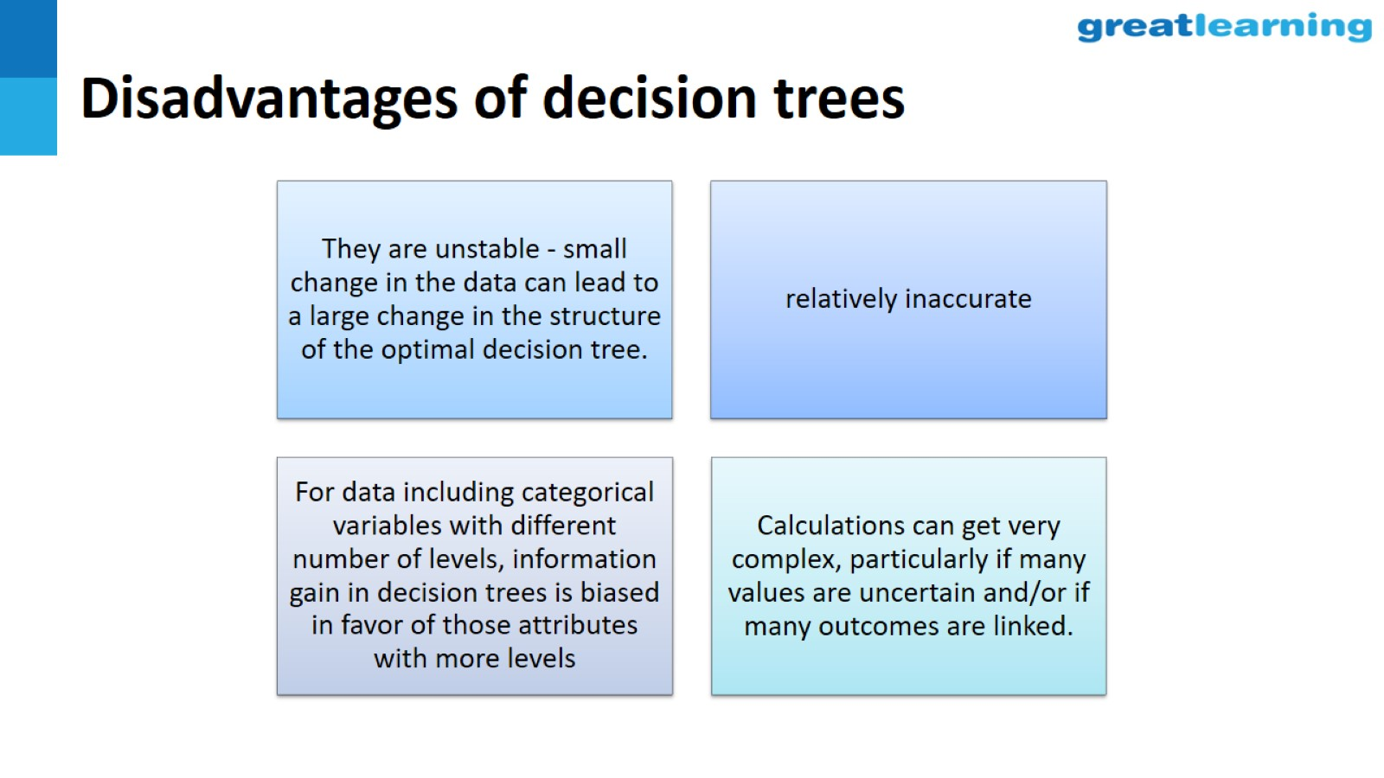
Disadvantages of decision trees

Slide 48


